Slide 1

Welcome to Year 5
Your child will be working with:
Mrs Mackay- Class Teacher
Mrs Tomlin – Teaching Assistant

Slide 2

Working in partnership
“Let all that you do be done in love”
1 Corinthians 16:14
We act with love, build our faith and grow as people.

Slide 3
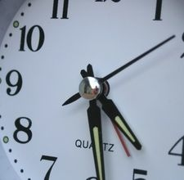
Breakfast Club starts: 7.45am
Drop off at the gates: 8.35am
Gates close 8:45am
Registration: 8.50am
Register closes: 9.00am
Lunchtime starts: 12.30pm
Lunchtime finishes: 1.30pm
School finishes: 3.15pm
Clubs after school 3.15-4.15pm
Splatz: 3.15- 6pm
Be on time! Even being just a few minutes late can get a child’s day off to a bad start.
During the first 10 or 15 minutes of the school day, children give in letters, choose lunch, organise their belongings, do their early work tasks.
Being 10 minutes late each day adds up to 50 minutes – the length of an average English or Maths lesson.

Slide 4

We want to know:
Inform us of any issues arising
Send an email to:
secretary@smc-brackell.com

Slide 5

IMPORTANT NOTE:
Issues which arise in school should be dealt with in school by the school.
Please do not approach other parents or children about incidents which have occurred in school, even if you know them well.
Class book to record incidents.

Slide 6

Social Media
We have an open door policy. If you have any concerns about the school or your child, please tell us directly.
Social media, or the playground, is not an appropriate forum to discuss issues concerning your children: it can often compound a problem and in our experience it is never part of the solution.

Slide 7
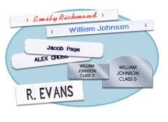

Uniform and Belongings
Your child is responsible for their own belongings.
The best way to support your child in doing this is to ensure that every item brought into school is clearly labelled..
Water bottles should be brought into school every day
(just water please).
PE kit - in school on a Monday and must remain in school all week.
Kit will go home on Thursday evenings for Fit Friday.
Yr 5 PE days are Wednesday and Friday
Plain black PE shorts or joggers (NO cycling shorts or leggings). Plain black hoodie.

Slide 8
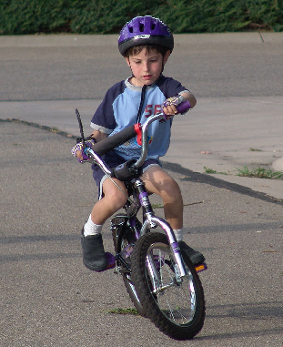
Independence
Pack/ empty own bag
Filling own water bottle
Take responsibility for letters
Taking care of own belongings
Labelling own belongings
Doing homework without reminders
Completing homework tasks independently – nothing new is set for homework, it is consolidation of class learning

Slide 9
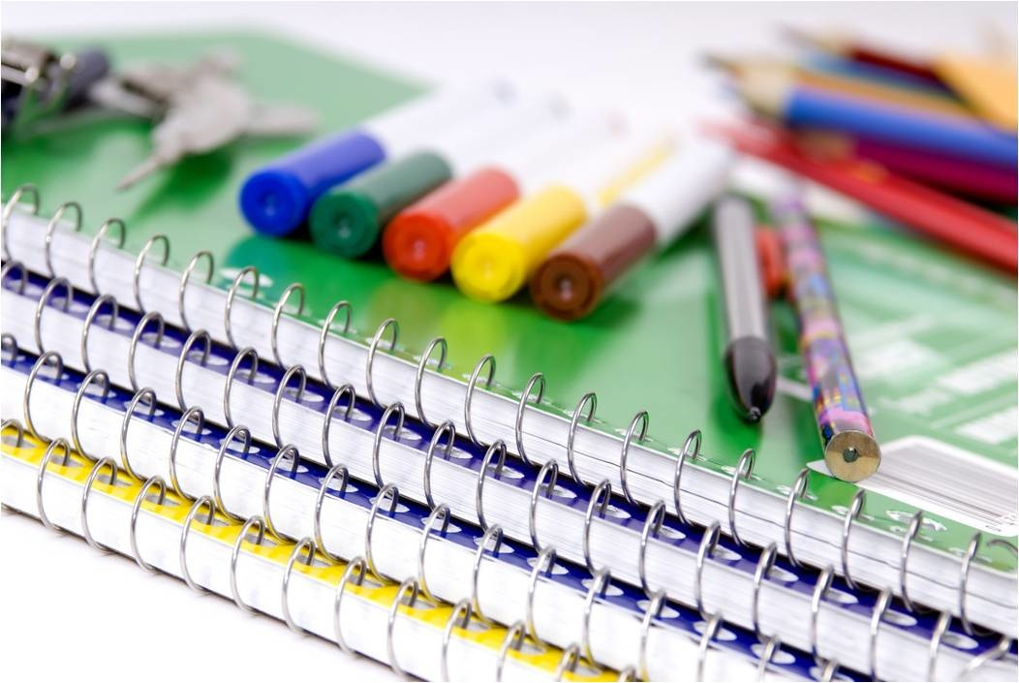
Pencil Cases
Please could your child bring in a small labelled pencil case
Items that would be very useful for your child :
●pencils
● a sharpener
● coloured pencils
● whiteboard pen
● glue stick
●rubber
Please ensure all items are labelled.

Slide 10
St Margaret Clitherow School Rules
Follow
Follow instructions given by all adults in the school
Keep
Keep hands, feet and objects to yourself
Treat
Treat equipment sensibly
Show
Show respect to all members of our school community
Listen
Listen carefully and respond appropriately

Slide 11
Success today at SMC!
6 Huge Achievement
5 Excellent today
4 Feeling proud
3 Successful day
2 Well done
1 Great start

Slide 12
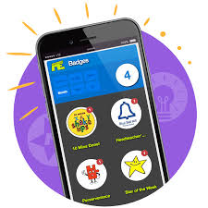

Rewards using Marvellous Me!

Slide 13
Bullying is never ok and always needs to be addressed
But bullying is not…
Not liking someone
Being excluded
Accidentally bumping into someone
Wanting to play a game their way
A single act of telling a joke about someone
Arguing
Isolated incidents of unpleasantness, aggression or meanness
However, all of these would be taken seriously and discussed as a learning point with your children.

Slide 14
There is no legal definition of bullying. However, it’s usually defined as behaviour that is:
repeated
intended to hurt someone either physically or emotionally
often aimed at certain groups, e.g. because of race, religion, gender or sexual orientation
It takes many forms and can include:
physical assault
teasing
making threats
name calling
cyber bullying - bullying via mobile phone or online (e.g. email, social networks and instant messenger)
Our anti-bullying policy is on the school website.

Slide 15
Places, partners and groups
Children will learn independently, in pairs and in groups.
Children’s places and groups will change regularly, according to learning styles, ability, social groups.
Children will work in several different groups over the course of a week.

Slide 16
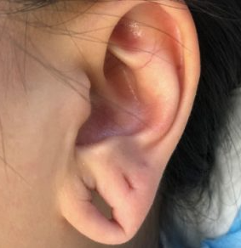
Earrings policy
A single stud earring in each ear is permitted.
Earrings must not be worn for PE and should be taken out the night before, or removed by the pupil before their lesson.
Staff are not permitted to tape ears for pupils and this should be done at home, if the piercings are new and cannot be removed.
Tape increases the risk of the earring being caught and pulled and could result in serious injury to the ear lobe.

Slide 17

Progress for every child
Work aims to be at correct level of challenge for each child
TA, SENCo or Class Teacher guided sessions
Additional support or challenge
Learning with others at similar level
Learning with others at different levels
Paired work
Same task, different expectations
Same objective, different task
Different objective, different task

Slide 18
Expected Progress in Year 5
Milestones have been set in order to ensure sufficient progress throughout the year.
Children making a slower rate of progress or who are at risk of not meeting their personal target are monitored closely, with various booster sessions and personalised tasks.
Children who are making accelerated progress are given opportunities to complete tasks which reflect their ability, with support as needed.

Slide 19
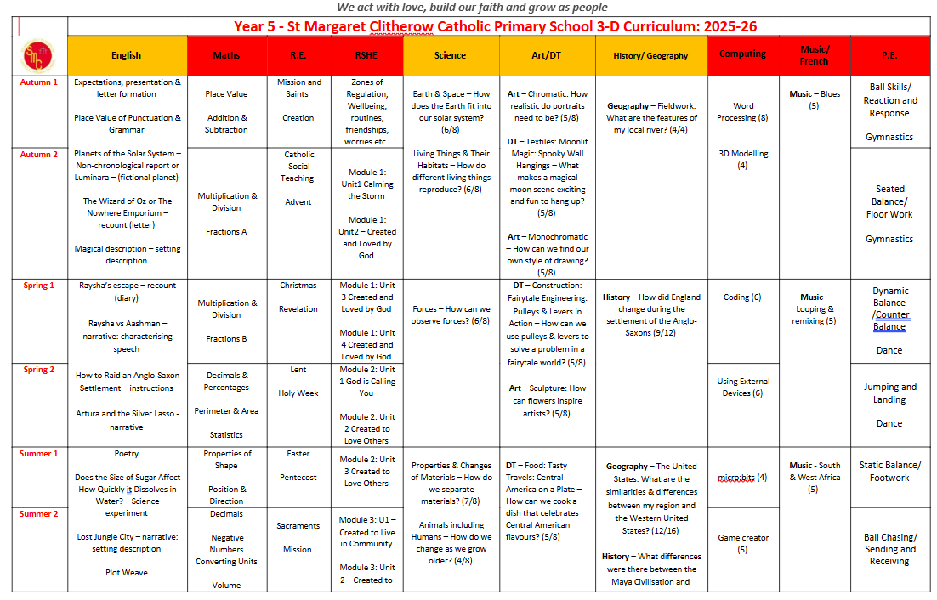
Topics in Year 5

Slide 20
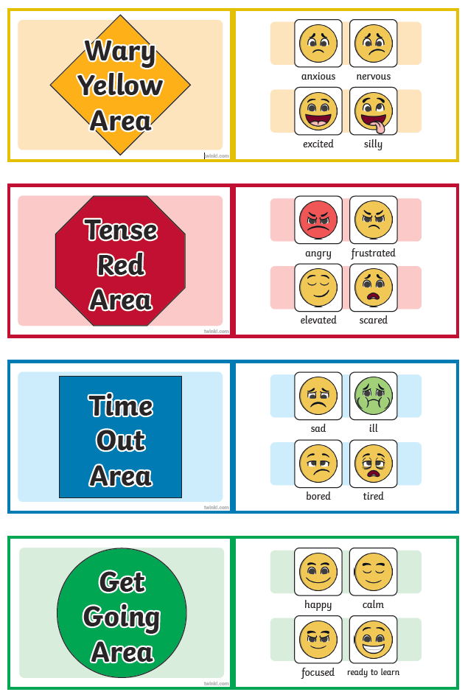
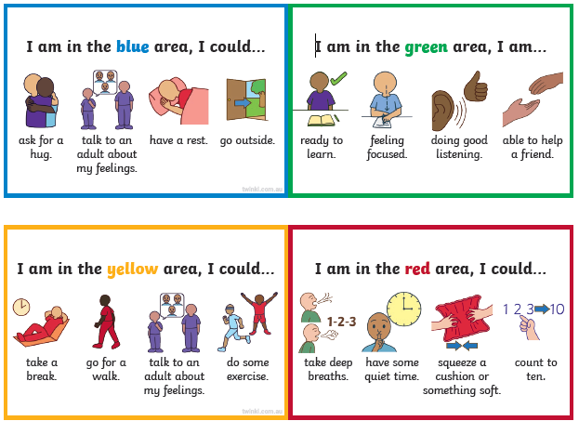
Zones of Regulation

Slide 21

Trips/ Events
Science Space trip - Spring 2: Cost approx. – £30 per pupil.
Junior Music Festival – Summer term (Hexagon Reading) School fee to cover transport to event only (approx. £8-10). Additional cost – venue tickets (paid to the venue directly approx. £16 each)
Print Making Workshop – November: Cost approx.- £10
Wilde Week Art workshop at South Hill Park- July: Cost approx.- £10
African Drumming Workshop TBC

Slide 22
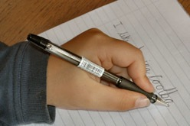
Handwriting
All handwriting MUST be joined and using a cursive style
We practise regularly in school .
Please encourage your child to carefully join their writing when completing their homework tasks
Handwriting being joined and legible is a part of their end of KS2 writing assessment.

Slide 23

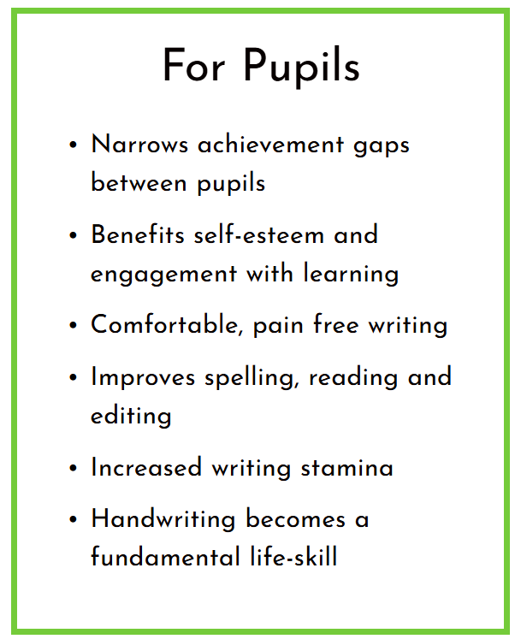
Kinetic letters
Kinetic Letters is an evidence- informed programme that builds the cognitive and physical skills for handwriting.
It makes handwriting a valuable tool rather than a hindrance, benefitting every curriculum area, self-esteem, and engagement with learning.
The programme combines knowledge of child- development, with expert understanding of the way in which pupils learn most effectively, to produce rapid results from any starting point.

Slide 24
Reading
Please ensure that your child reads daily and you hear your child read aloud – aim for 10mins each day.
Reading is not just about de-coding. Ask your child questions which require them to make inferences and deduction from the text – in other words, can they read between the lines?
Please ensure your child’s reading record and reading book is in school every day.
Reading Inspiration Station - Children may make use of the new reading corner in class, in addition to the library, to access a range of age appropriate texts.

Slide 25
Purpose of Homework
Consolidates recent work
Reinforces basics
Informs future planning
Supports independent learning
Provides a dialogue about learning between child, parent and teacher
Celebrates success

Slide 26
Getting Homework
Given out on a Thursday
Submitted by the following Tuesday
Will always be a TTRS activity plus Spelling Shed each week.
Dependent on individual pupil need, there may also be individual handwriting, grammar, maths etc.
May be differentiated or have an element of choice
Tasks are explained during lessons and examples worked through where necessary
Any problems, please see me or send a quick email ahead of when it is due!

Slide 27
Feedback for Homework.
Marvellous Me House points are used to reward exceptional effort in homework.
Feedback for these tasks is often verbal.
Tasks should be completed independently. If a lot of support is needed, please let me know.
Please do not spend excessive time on homework (20 mins per piece is a guide – family life comes first!)
When in doubt work on the reading and the spellings as the priority.

Slide 28
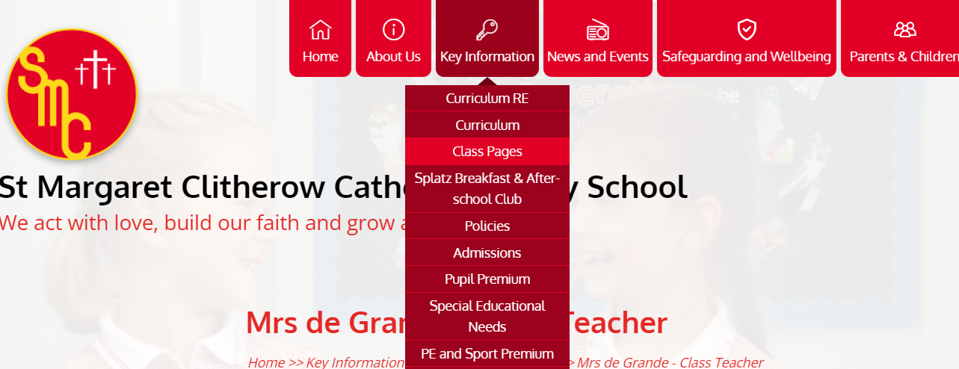
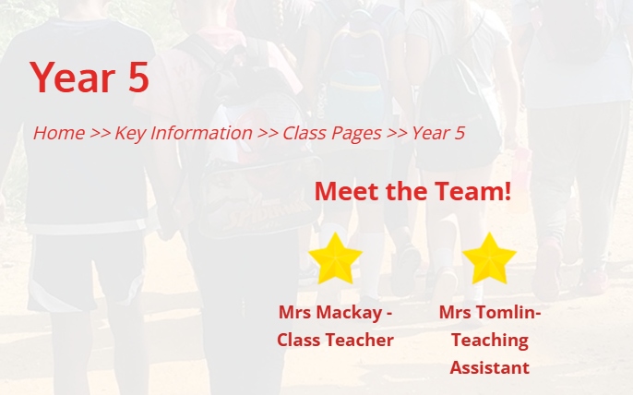
Website Class Page

Slide 29

There will be individual parent appointments on Wednesday 12th November 1.30pm to 7pm and Wednesday 4th March 1.30pm-7pm but please make an appointment to see me at any time should the need arise.
Don’t wait if you have a concern!
Any questions?
Thank you for coming.

