Slide 1

Welcome to Year 2
Your child will be working with:
Mrs de Grande (Mon, Tues, Thurs & Fri)
Mrs Frost – Teaching Assistant
Mrs Snowball (Weds)

Slide 2

Working in partnership
“Let all that you do be done in love”
1 Corinthians 16:14
We act with love, build our faith and grow as people.

Slide 3

We want to know:
Inform us of any issues arising
Send an email to:
secretary@smc-brackell.com

Slide 4

IMPORTANT NOTE:
Issues which arise in school should be dealt with in school by the school.
Please do not approach other parents or children about incidents which have occurred in school, even if you know them well.
Class book to record incidents.

Slide 5

Social Media
We have an open door policy. If you have any concerns about the school or your child, please tell us directly.
Social media, or the playground, is not an appropriate forum to discuss issues concerning your children: it can often compound a problem and in our experience it is never part of the solution.

Slide 6
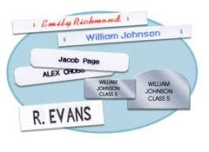

Uniform and Belongings
Your child is responsible for their own belongings.
The best way to support your child in doing this is to ensure that every item brought into school is clearly labelled..
Water bottles should be brought into school every day
(just water please).
PE kit - in school on a Monday and must remain in school all week.
Kit will go home on Thursday evenings for Fit Friday.
(Yr 2 PE days are Monday and Friday – so this is nice and easy)
Plain black PE shorts or joggers (not cycling shorts or leggings). Plain black hoodie.

Slide 7
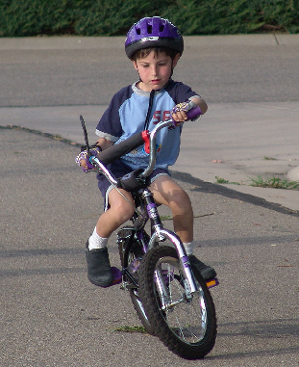
Independence
Pack/ empty own bag
Filling own water bottle
Take responsibility for letters
Taking care of own belongings
Labelling own belongings
Doing homework without reminders
Completing homework tasks independently – nothing new is set for homework, it is consolidation of class learning

Slide 8
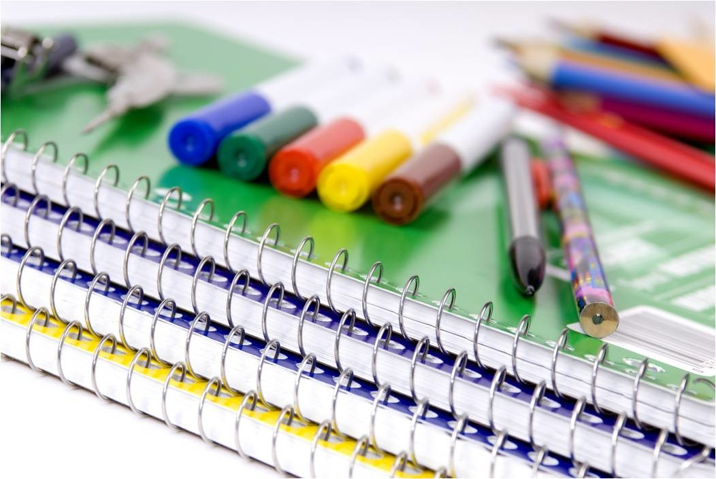
Pencil Cases
Please could your child bring in a small labelled pencil case.
Items that would be very useful for your child :
pencils / pens (depending on age)
a sharpener
a rubber
coloured pencils
whiteboard pen
glue stick
Please ensure all items are labelled.

Slide 9
St Margaret Clitherow School Rules
Follow
Follow instructions given by all adults in the school
Keep
Keep hands, feet and objects to yourself
Treat
Treat equipment sensibly
Show
Show respect to all members of our school community
Listen
Listen carefully and respond appropriately

Slide 10
Success today at SMC!
6 Huge Achievement
5 Excellent today
4 Feeling proud
3 Successful day
2 Well done
1 Great start

Slide 11
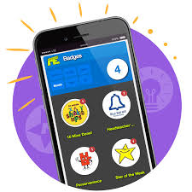

Rewards using Marvellous Me!

Slide 12
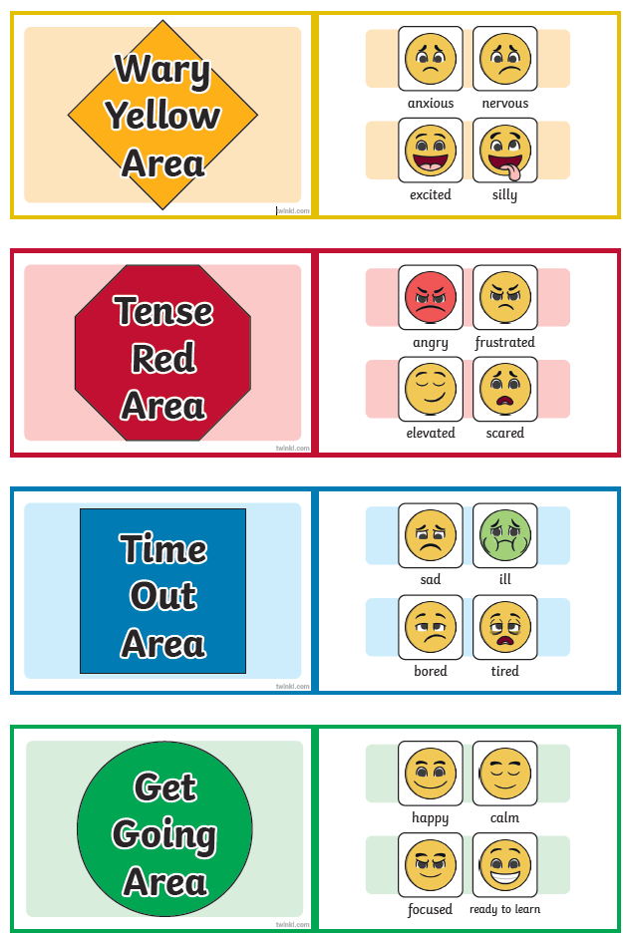
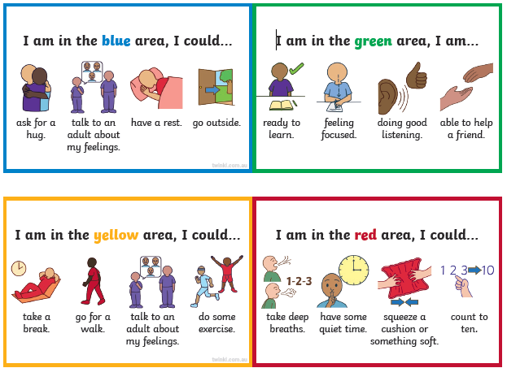
Zones of Regulation

Slide 13
Bullying is never ok and always needs to be addressed
But bullying is not…
Not liking someone
Being excluded
Accidentally bumping into someone
Wanting to play a game their way
A single act of telling a joke about someone
Arguing
Isolated incidents of unpleasantness, aggression or meanness
However, all of these would be taken seriously and discussed as a learning point with your children.

Slide 14
There is no legal definition of bullying. However, it’s usually defined as behaviour that is:
repeated
intended to hurt someone either physically or emotionally
often aimed at certain groups, e.g. because of race, religion, gender or sexual orientation
It takes many forms and can include:
physical assault
teasing
making threats
name calling
cyber bullying - bullying via mobile phone or online (e.g. email, social networks and instant messenger)
Our anti-bullying policy is on the school website.

Slide 15
Places, partners and groups
Children will learn independently, in pairs and in groups.
Children’s places and groups will change regularly, according to learning styles, ability, social groups.
Children will work in several different groups over the course of a week and with different adults.

Slide 16
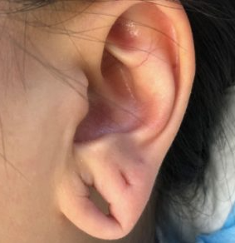
Earrings policy
A single stud earring in each ear is permitted only.
Earrings must not be worn for PE and should be taken out the night before, or removed by the pupil before their lesson.
Staff are not permitted to tape ears for pupils and this should be done at home, if the piercings are new and cannot be removed.
Tape increases the risk of the earring being caught and pulled and could result in serious injury to the ear lobe.

Slide 17
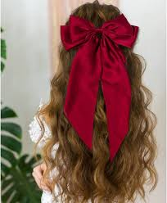
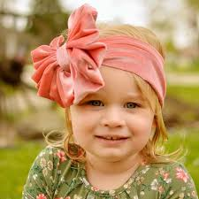
Hair
Mid-length to long hair is to be tied back at all times.
We may ask long fringes to be clipped back if they are preventing a child from seeing their work.
Please use school colour or plain black/ brown hair ties only.
Large bows and shiny headbands/ animal/ fancy headbands are not permitted.

Slide 18

Progress for every child
Work aims to be at correct level of challenge for each child
TA, SENCo or Class Teacher guided sessions
Additional support or challenge
Learning with others at similar level
Learning with others at different levels
Paired work
Same task, different expectations
Same objective, different task
Different objective, different task

Slide 19
Expected Progress in Year 2
Milestones have been set in order to ensure sufficient progress throughout the year.
Children making a slower rate of progress or who are at risk of not meeting their personal target are monitored closely, with various booster sessions and personalised tasks.
Children who are making accelerated progress are given opportunities to complete tasks which reflect their ability, with support as needed.

Slide 20
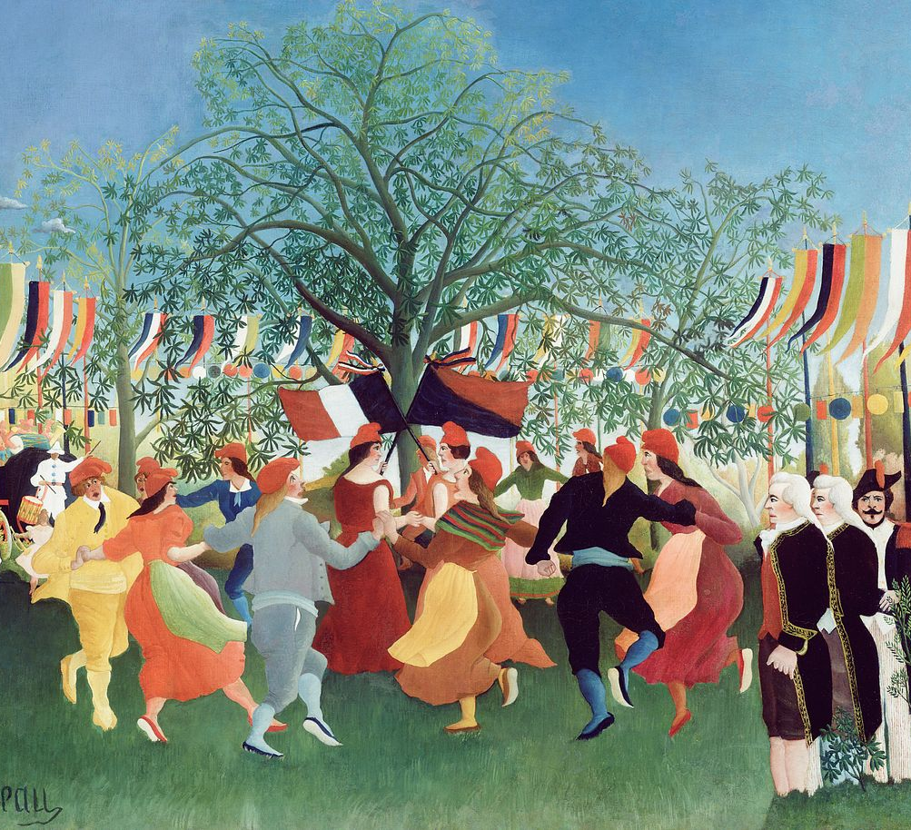
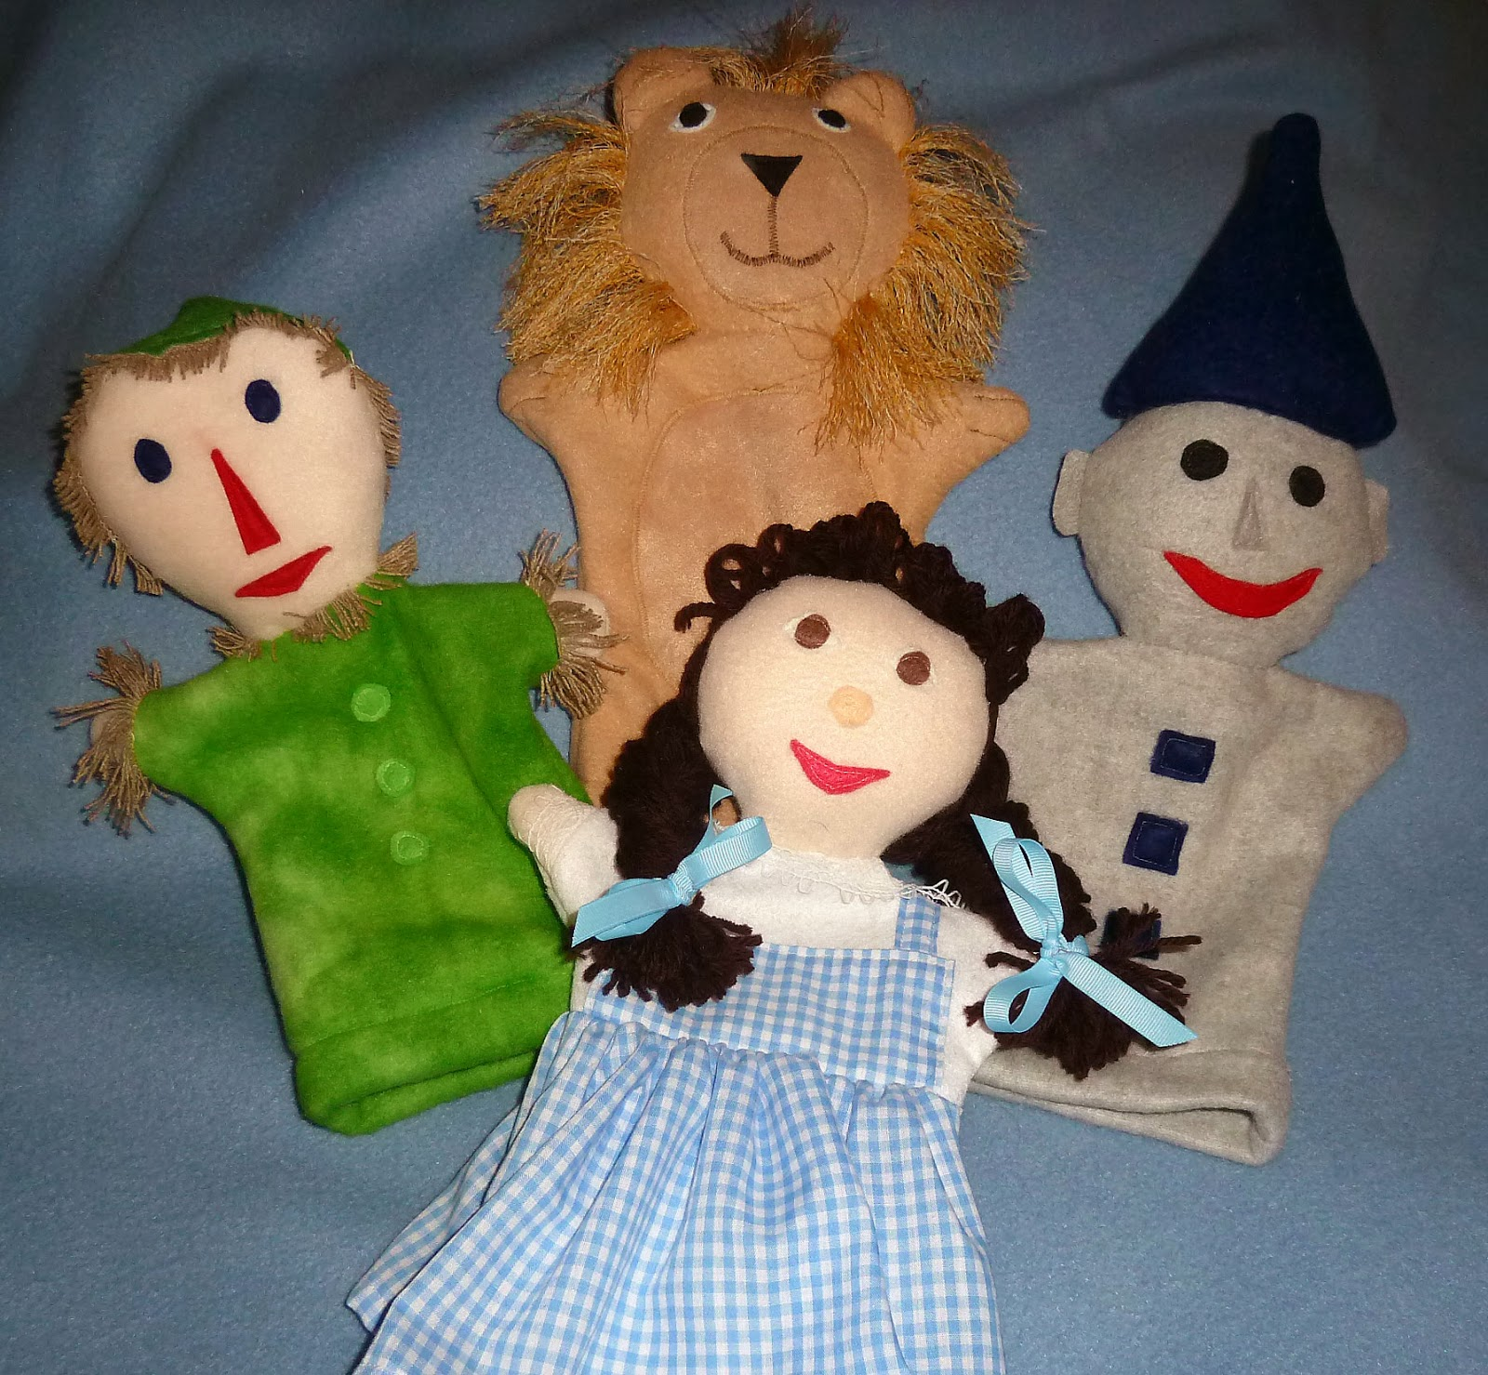
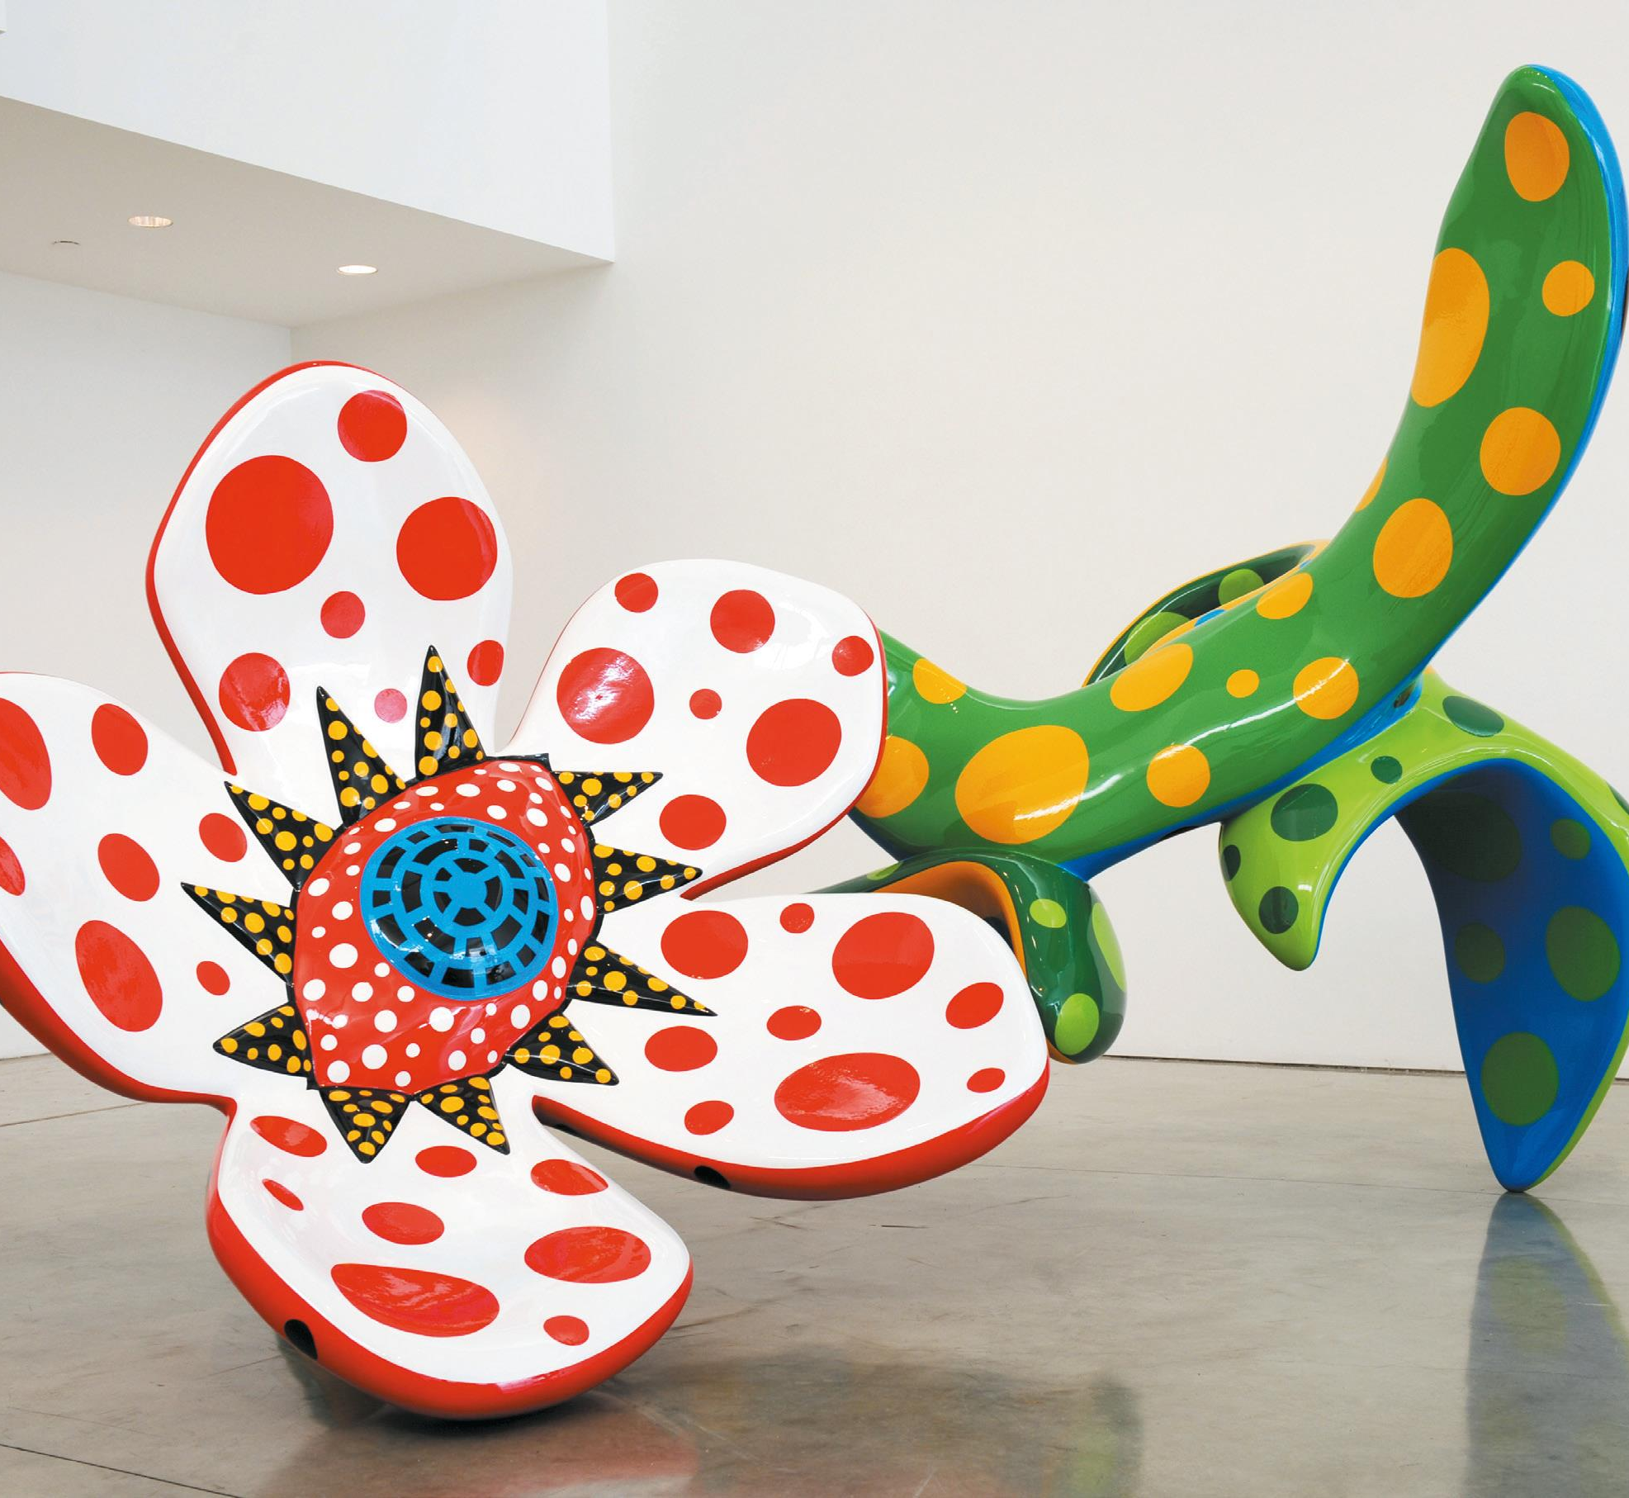
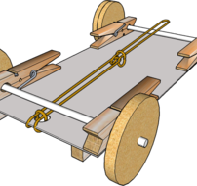
ART & DT
  ART
  Yayoi Kusama
  Earth Art
  Henri Rousseau
  DT
  Puppets
  Vehicles
  Perfect Pizzas

Slide 21
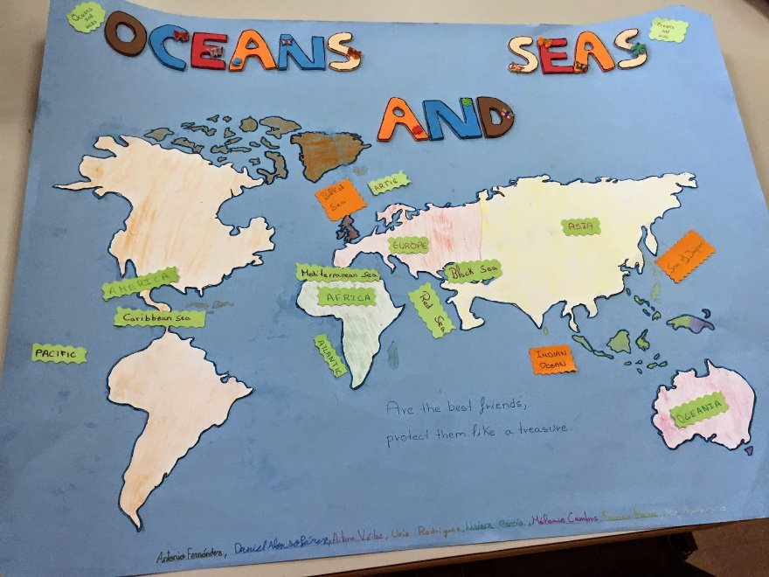
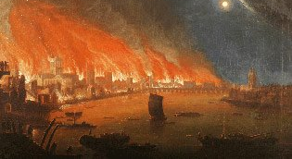
History & Geography
  Geography
  Continents & Oceans
  Hot & Cold Places
  Mugumareno Village, Zambia
  DT
  Puppets
  Vehicles
  Perfect Pizzas

Slide 22
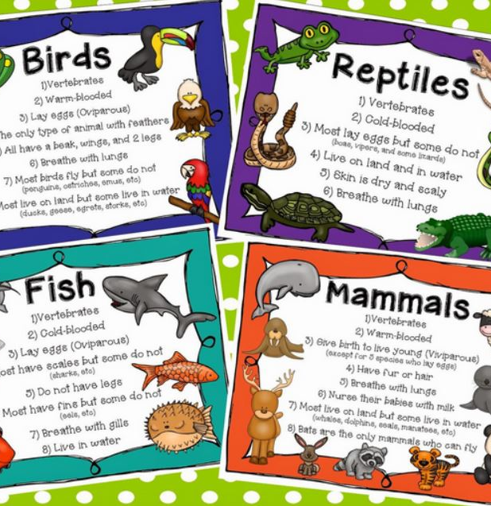

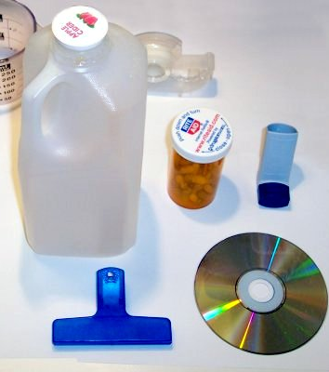
Science
Animals & Their Habitats
Animals including Humans
Everyday Materials
Plants

Slide 23
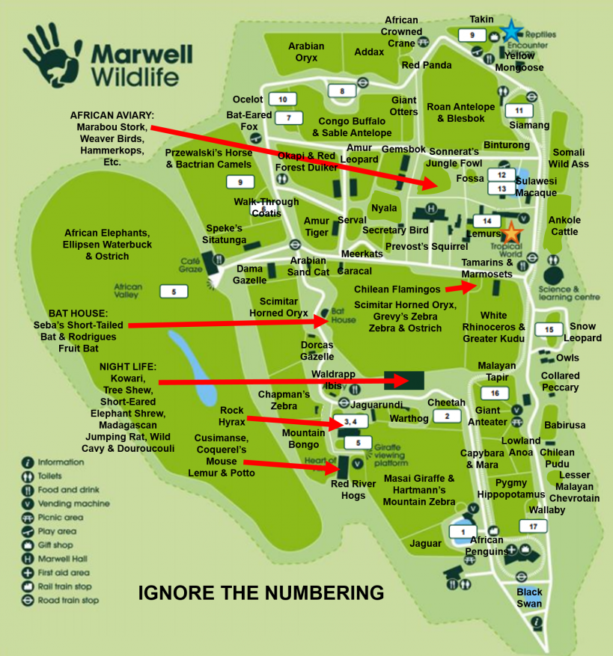
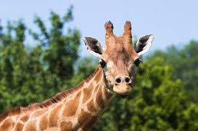
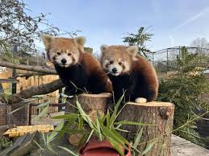
Trips/ Events
Tuesday 20th May – Marwell Zoo
  Approx. cost £30

Slide 24
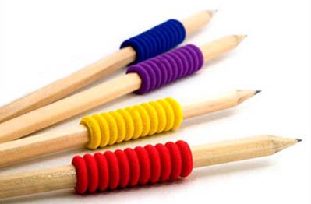
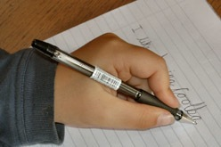
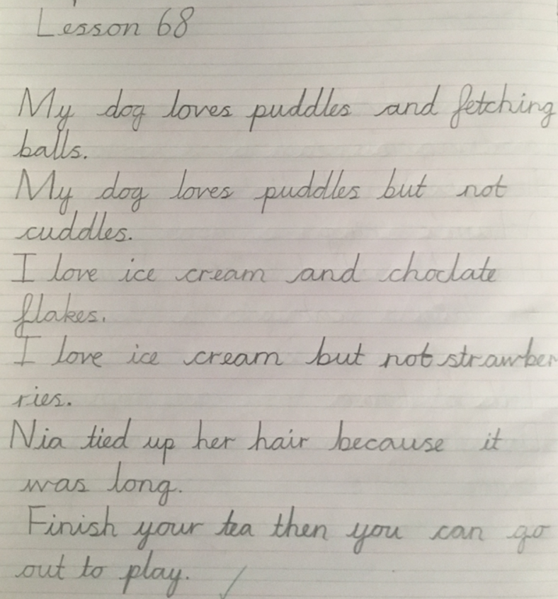
Handwriting
All handwriting MUST be joined and using a cursive style
We practise regularly in school and use Teach Handwriting which can be accessed at home .
Handwriting booklets will be issued to support progress.
We may recommend handwriting aids to support the correct pencil grip. We use the grip and flick method to support the correct hold.
Handwriting being joined and legible is a part of their end of KS2 writing assessment.

Slide 25
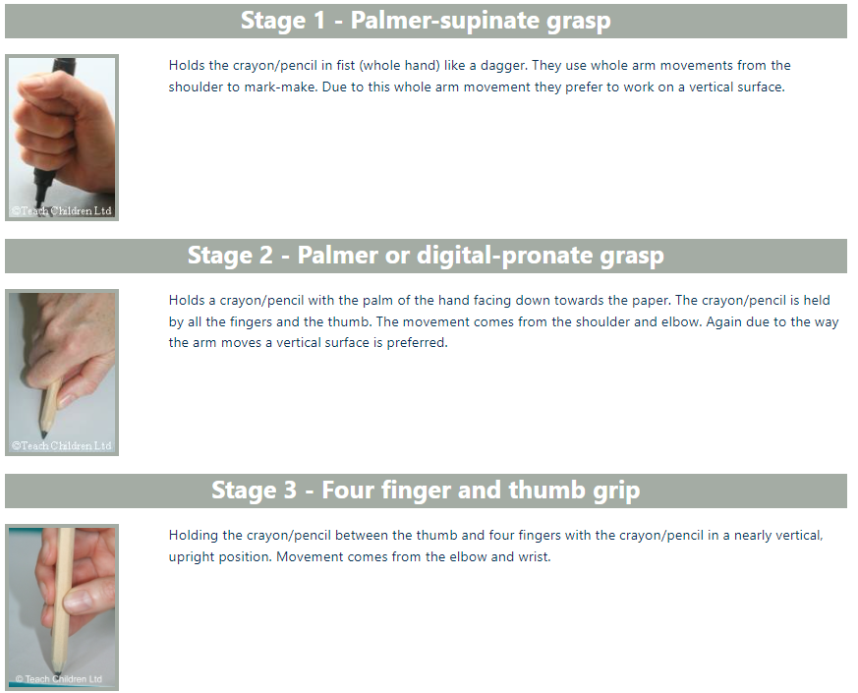

Slide 26
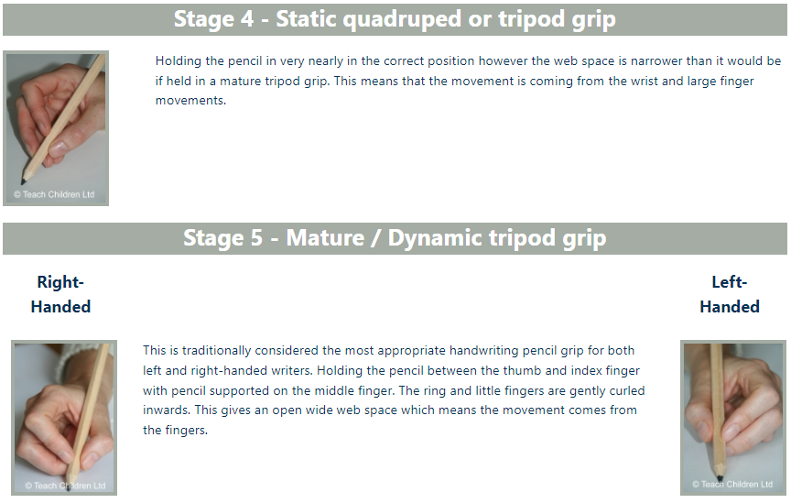

Slide 27
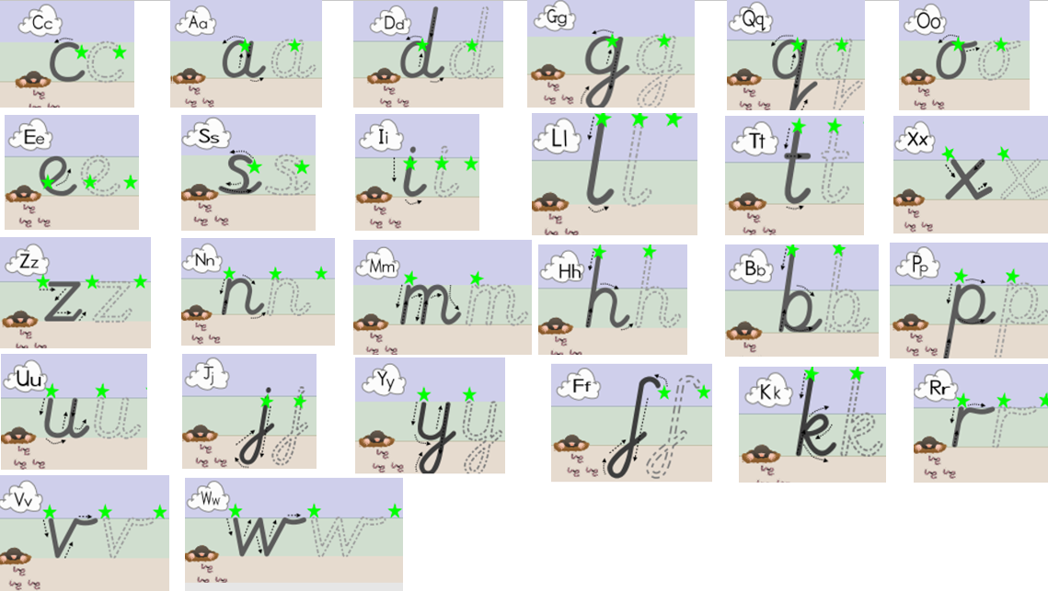

Slide 28
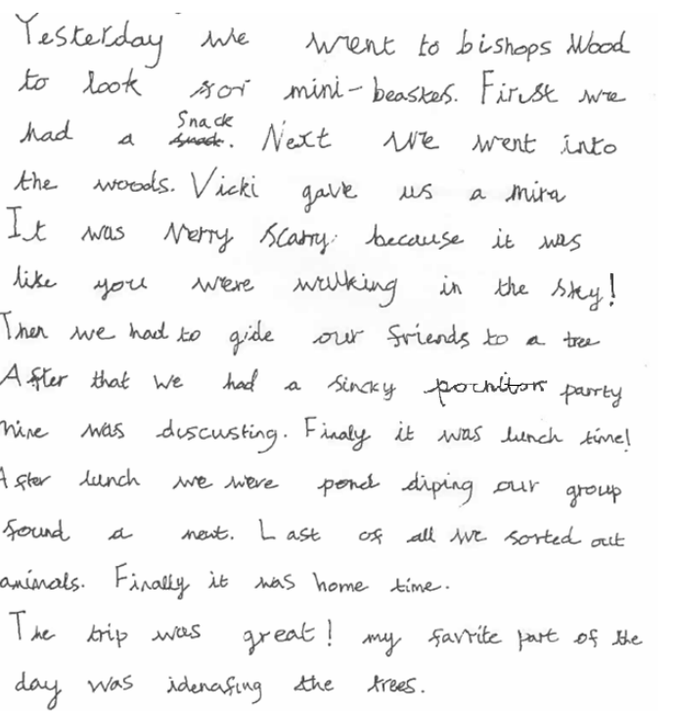
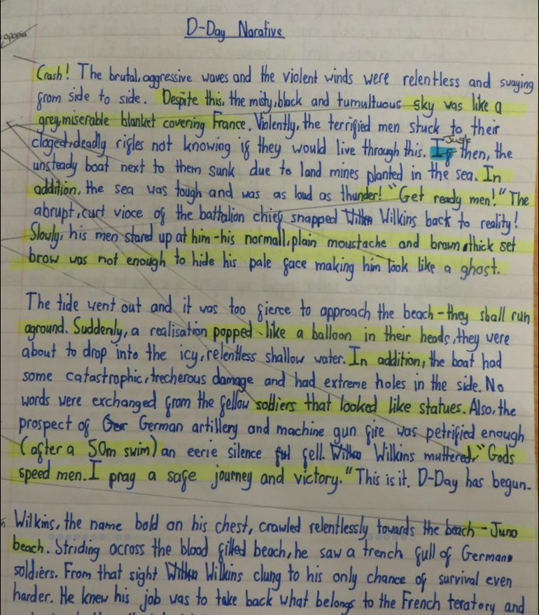
Year 2 Expected Standard

Slide 29
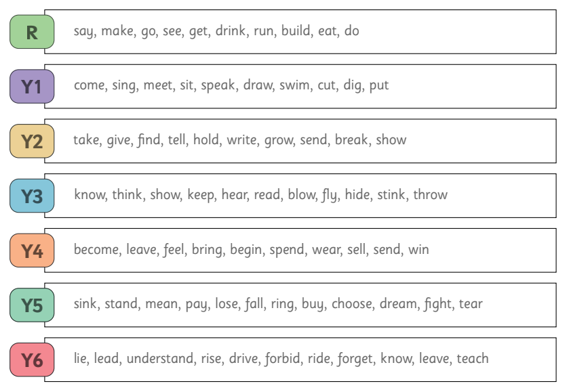
Verb progression

Slide 30
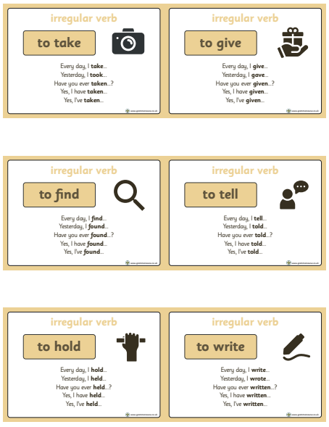
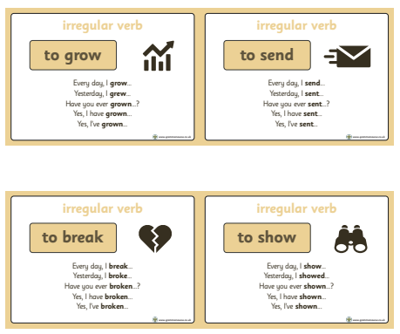
Verb progression

Slide 31
Reading
Please ensure that your child reads daily and you hear your child read aloud – aim for 10mins each day.
Please ensure your child’s reading record and reading book is in school every day.
Reading Corner - Children may make use of the reading corner in class, in addition to the library, to access a range of age appropriate texts.
Reading is not just about de-coding. Ask your child questions which require them to make inferences and deduction from the text – in other words, can they read between the lines?

Slide 32
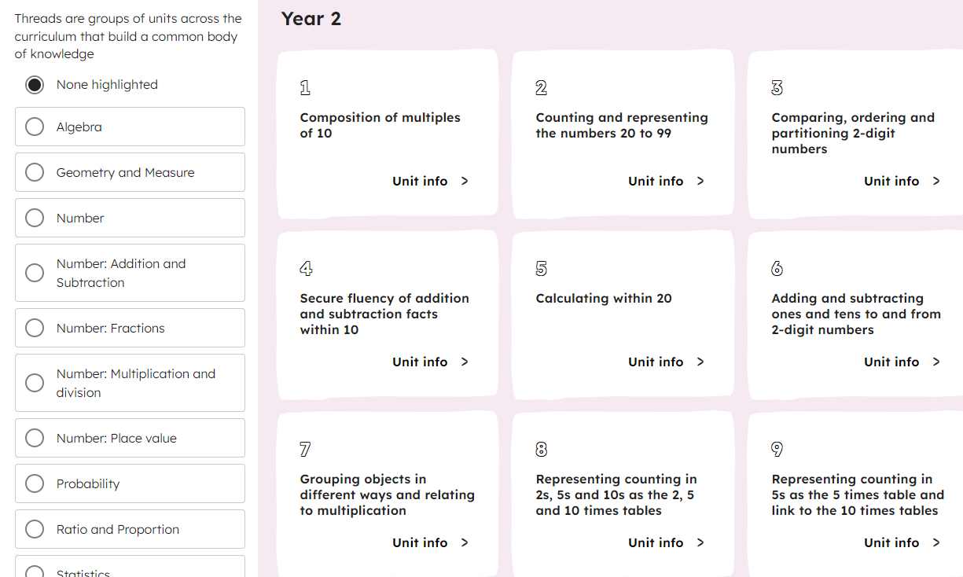
Maths
https://www.thenational.academy/teachers/curriculum/maths-primary/units
We use Oak Academy maths teaching which is supported by the National Centre for Excellence in Teaching Maths (NCETM).

Slide 33
Examples of questions to support home reading
Setting: Where is the story set?
Characters: Who are the characters? What words would you use to describe them?
Plot: What happened next? How does the story unfold?
Predictions: What do you think will happen? How do you think the story will end?
Inference: What do you think the author is trying to say? What doe a word or phrase mean in context?
Comparison: How does this story compare to another? Which is better? Why?
Reaction: What do you like or dislike about the story? Why?
Real life: Could this story be true? Do you know anyone like the characters?
Recommendation: Would you recommend this book to a friend? Why or why not
Editing: If you were to edit the story, which parts would you change?
(Make the questions as specific to the text being read as possible.

Slide 34
Purpose of Homework
Consolidates recent work
Reinforces the basics
Informs future planning
Supports independent learning
Provides a dialogue about learning between child, parent and teacher
Celebrates success

Slide 35
Getting Homework
Given out on a Thursday
Submitted by the following Tuesday
Will always be:
  Reading (daily),
  Numbots (practice 30 mins per week minimum – split into 5 to 10 min sessions)
  Phonics/ Spelling / Handwriting practice
Dependent on individual pupil need, there may also be individual handwriting, grammar, maths etc.
May be differentiated or have an element of choice
Any problems, please see me or send a quick email ahead of when it is due!

Slide 36
Feedback for Homework.
Marvellous Me House points are used to reward exceptional effort in homework.
Feedback for these tasks is usually verbal.
Maths/ spelling tasks should be completed independently. If a lot of support is needed, please let me know.

Slide 37

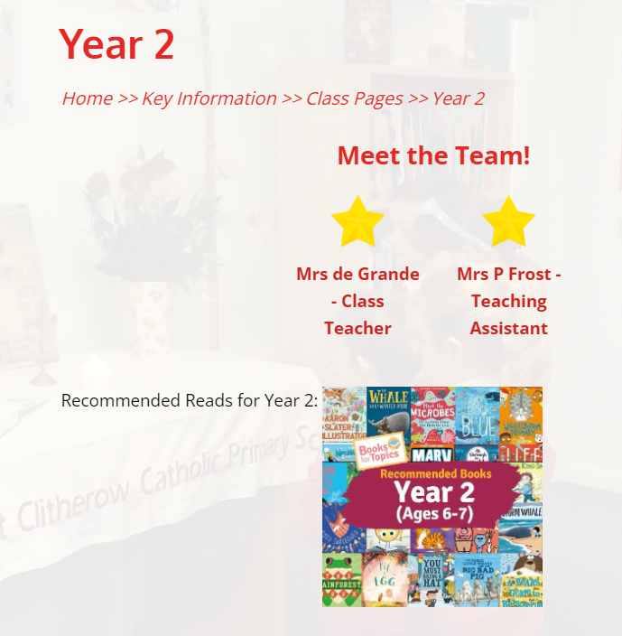
Website Class Page

Slide 38

Parents’ Afternoon/Evening:
There will be individual parent appointments are on
Wednesday 13th November, but please make an appointment to see me at any time should the need arise.
Don’t wait if you have a concern!
Any questions?
Thank you for coming.

