Slide 1
A-Z of Authors
Year 3 & 4

Slide 2
A
B
C
D
E
F
G
H
I
J
K
L
M
N
O
P
Q
R
S
T
U
V
W
X
Y
Z

Slide 3

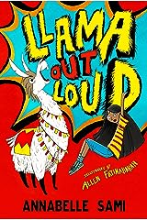
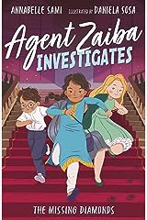
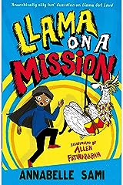
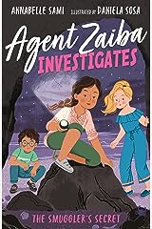
A – Annabelle Sami
Annabelle Sami weaves delightful and engaging stories for young readers. Her books embrace diverse themes and relatable characters, resonating deeply with audiences. Sami's narratives are filled with humour and heart, making them a joy to read. Through her skilful storytelling, she fosters empathy and understanding, encouraging young minds to embrace differences and celebrate individuality. Annabelle Sami's works serve as mirrors for underrepresented voices, promoting inclusivity in children's literature.

Slide 4
A – Annabelle Sami
There are some stories that are hard to believe. If you're smart (which I can already tell you are, dear reader) then you won't be lieve everything you're told. For instance, I've never trusted fairy tales. I mean, come on. Do they expect us to believe that you can survive being eaten by a wolf? I'm also pretty sure that a house made of gingerbread would melt in the rain, or at least attract a few flies.
Since you're clever, I'm sure you've always questioned those horror stories about kids that lost all their teeth eating too many sweets. Maybe you've watched a film and annoyed your friends by saying, 'That would never happen in real life!'
Well, I'll be honest with you. This story is hard to believe. But unlike a fairy tale, it doesn't take place in a faraway kingdom. Instead, we'll be travelling to the streets of Whitechapel in East London - a place you might hear the locals call 'The Ends'- where you can buy a samosa for a pound or a rainbow-coloured bagel from the many street vendors on Brick Lane. People from all around the world live under this one postcode, and even more come to visit on Sundays when the market is in full swing. It's a small corner of London, but there's a whole world inside it. And, despite what you might be thinking, the hero of our story isn't some cockney geezer. It's a girl - Yasmin.
Oh, and a llama. A toy one, of course, not a real one. That would be weird.
By now you must be thinking, that does sound unbelievable! I know. But believe me. It's real.
Extract

Slide 5
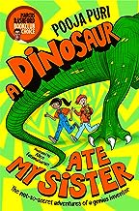
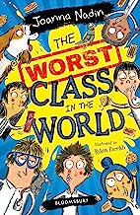
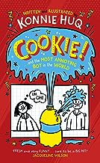
A – Annabelle Sami
Similar Authors
Pooja
Puri
Joanna Nadin
Konnie
Huq

Slide 6

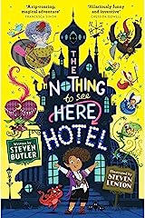
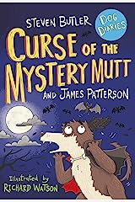
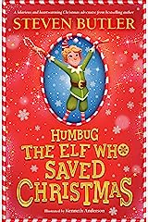
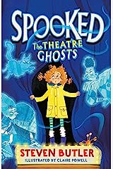
B – Steven Butler
Steven Butler captivates young readers with his hilarious and adventurous tales. His books are filled with laugh-out-loud moments and relatable characters that children adore. Butler's imaginative storytelling takes readers on exciting journeys, sparking curiosity and wonder. Through his clever and heart-warming narratives, he imparts valuable life lessons about friendship, courage, and perseverance. Steven Butler's works are a perfect blend of humour and heart. His captivating stories entertain and inspire young minds.

Slide 7
B – Steven Butler
Let’s talk about grandmas ... In storybooks, grandmas or grannies or nannies are sweet and short dumplings of fun that give you extra pocket money when your mum and dad aren’t looking, and need to be rescued from the occasional big bad wolf. BUT ... this isn’t a storybook. This is really-real life, and my grandma isn’t anything like that. My granny would terrify the big bad wolf. She’d beat him to a pulp. She’d gulp him down, chewing and slobbering as she did so, and belch out his bones before breakfast. Oh ... I should probably tell you ... My granny is a TROLL. A mean one.
Phew! Now I’ve told you the truth about my granny, the rest of what I’m about to tell you won’t sound quite so bonkers. My name is Frankie by the way . . . Frankie Banister. Hello! I know you’re probably already thinking that I’ve had my brains scrambled or I’m loop-de-loop crazy – a troll for a granny?! But we’ve only just started: keep reading and I’ll explain everything, I swear. You’ll begin to believe me in no time . . . my granny really is a hulking, stinky great troll, and not a single word of what I’m about to tell you is a lie. Go on, just a few more pages . . . Ready? Here we go ...
Extract

Slide 8
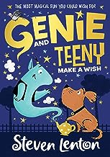
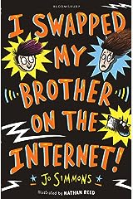
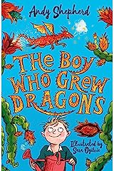
B – Steven Butler
Similar Authors
Steven
Lenton
Jo
Simmons
Andy Shepherd

Slide 9
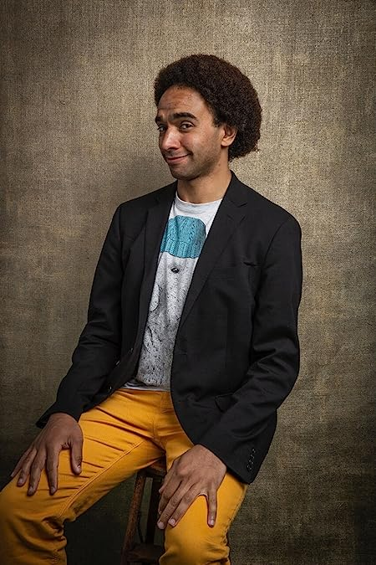
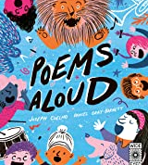
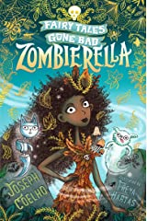
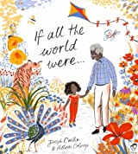
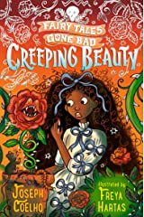
C – Joseph Coelho
Joseph Coelho, the current children’s laureate is a gifted poet and author who creates powerful and emotive stories that resonate with young readers. His books explore complex emotions and important life themes with grace and sensitivity. Coelho's evocative storytelling and captivating use of language transport readers on poignant journeys of self-discovery and resilience. Through his works, he encourages empathy and understanding. Joseph Coelho's words have the power to touch young hearts and inspire a love for poetry and literature.

Slide 10
C – Joseph Coelho
Hello, I'm The Librarian.
I used to believe in nice things! Sweet things.
Fairy tales and butterflies that don't bite.
Then I began to work in the library. In the reference section.
The section for adults only
where there are big books,
dangerous books, forbidden books.
I spent my days stamping books, shelving books
and reading... books.
I found a hidden section at the back of the library, covered in powdery dust as thick as snow.
A section full of old books, unthumbed books, unread books, unloved books.
You know how when you leave fruit in a bowl
uneaten, it goes off? flies lay eggs, maggots squirm,
Mould starts to bloom on the skin, the flesh goes brown and soft,
horrid smells find their way into the fruit... The same happens with books!
The same had happened to these books.
These books, these fairytales, had gone off.
Extract

Slide 11
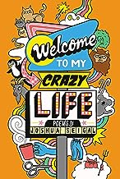
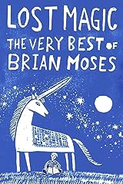
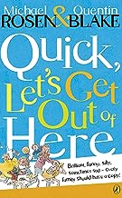
C – Joseph Coelho
Similar Authors
Joshua
Seigal
Brian
Moses
Michael
Rosen

Slide 12
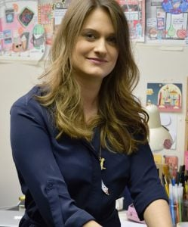
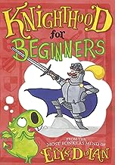
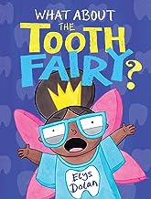
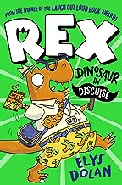
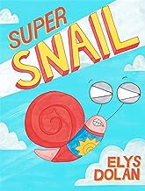
D – Elys Dolan
Elys Dolan brings joy and laughter to young readers with her imaginative and humorous stories. Her books are filled with vibrant illustrations and quirky characters that captivate the imagination. Dolan's clever storytelling and witty dialogue create an entertaining and engaging reading experience for children that will leave them rolling on the floor with laughter.

Slide 13
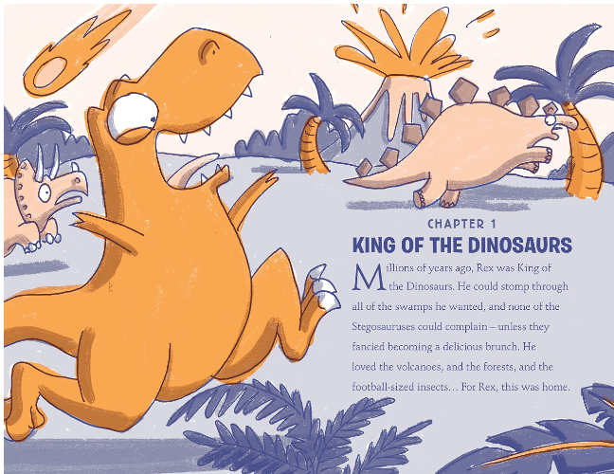
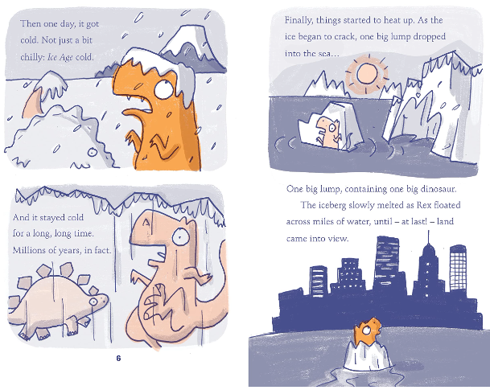
D – Elys Dolan
Extract

Slide 14
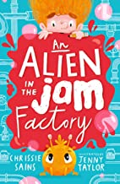
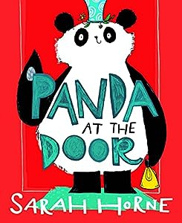
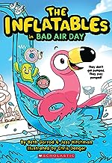
D – Elys Dolan
Similar Authors
Chrissie
Sains
Sarah Horne
Beth
Garrod

Slide 15

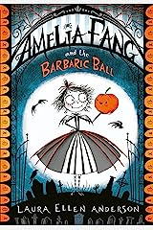
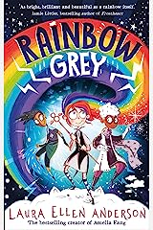
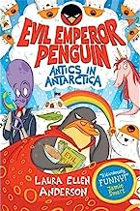
E – Laura Ellen Anderson
Laura Ellen Anderson enchants young readers with her magical and whimsical stories. Her books are filled with fantastical worlds and endearing characters that captivate the imagination. Anderson's evocative storytelling and charming illustrations create an immersive reading experience. Through her delightful narratives, she imparts important life lessons about friendship, bravery, and embracing one's uniqueness. Her captivating stories continue to spark wonder and joy in young minds.

Slide 16
E – Laura Ellen Anderson
It was a dark and gloomy Wednesday night in Nocturnia. Countess Frivoleeta Fang sipped at her Scream Tea and tapped the diningroom table with her long black fingernails as the clock struck 4 a.m. ‘Drake, my darkness, you do know it’s our annual Barbaric Ball in just three nights?’ cooed Countess Frivoleeta. ‘We still have invitations to send, catering to sort out and – oh, did you book the Howling Wolf Band?’ Count Drake’s eyes widened. ‘Erm . . . I’ll phone them tonight, dearest rat brains.’ ‘And Drakey, you’ll need to wear your best suit for the ball. None of those Hawaiian graveyard shirts you like so much. We really must find a way to unstick all that goblin slime from last year’s ball too . . .’ (Goblins were notorious for leaving slime trails – stickier than the stickiest super glue, they were impossible to remove!) ‘Not another Barbaric Ball,’ moaned Amelia Fang, slumping back into her chair. ‘They’re always full of old monsters wearing too many frills and far too much Eau de Decay.’ Amelia had just turned ten and would much rather be hanging out with her best friends, Florence and Grimaldi. ‘Amelia Fang! I won’t have any of that bat-chat from you,’ said the countess sternly.
‘Firstly, Eau de Decay is the finest perfume in all of Nocturnia. It’s made from fermented bat spit with a hint of rotten banana, after all! And secondly, the Barbaric Ball is a family tradition. It’s our chance to show everyone how fang-tastic we are.’ Hosted by the Fang family for generations, the Barbaric Ball was THE annual event
in Nocturnia. Only the most ghoulish and ghastly were invited, and the ball was Countess Frivoleeta’s pride and joy. ‘But I get so bored,’ Amelia grumbled. ‘It would be much better if someone my own age were there!’
Extract

Slide 17
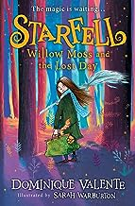
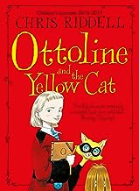
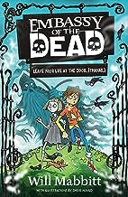
E – Laura Ellen Anderson
Similar Authors
Dominique Valente
Chris
Riddell
Will
Mabbitt

Slide 18
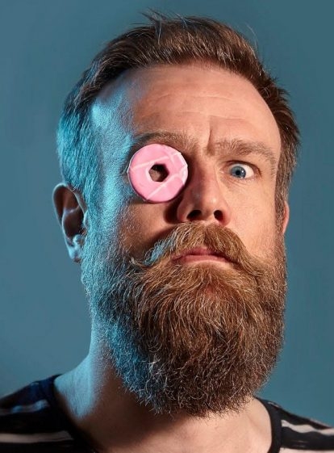
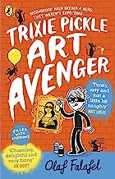
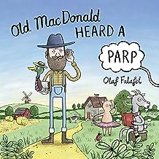
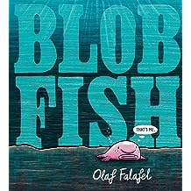
F – Olaf Falafel
Olaf Falafel tickles young readers' funny bones with his witty and quirky stories. His books are filled with laugh-out-loud moments and clever wordplay that children adore. Falafel's unique sense of humour and engaging storytelling keep readers entertained from start to finish. Through his humorous narratives, he encourages a love for reading and inspires creativity. Olaf Falafel's works are a delightful blend of silliness and wit.

Slide 19
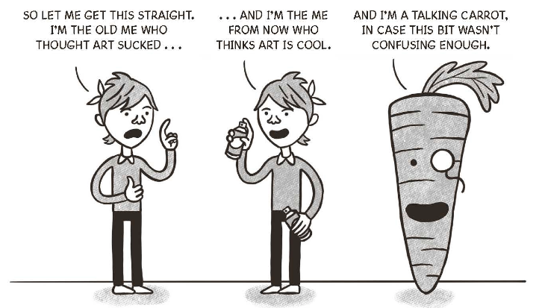
F – Olaf Falafel
Hello Reader, I want to start by telling you that art sucks! There you go – I said it – ART IS SUCKY!
Although when I say 'There you go, I've said it - ART IS SUCKY' it's not really me saying that; it's the person who I was before all the stuff that happens in this book happened (which I guess is technically still my, but it's not the me who is currently talking to you right this minute).
Sorry for such a complicated beginning - it's just my way of letting you know that I USED to be like a lot of you: I USED to think art was boring.
Don't get me wrong I really like drawing. If you ask me, some of my cartoons should qualify as art, but my art teacher, Mr Woodhouse, doesn't agree. He discovered my 'Teachers of Wormwood High Reimagined as Insects' drawing in the back of my book and he gave me after- school detention cleaning paintbrushes. I dread to think what he'd be like if he saw any of my actual comic strips (I'll show you some of those later on in this book).
Extract

Slide 20
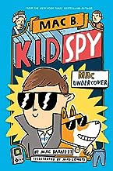
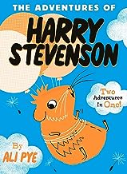
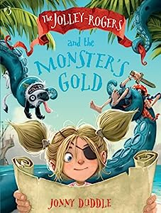
F – Olaf Falafel
Similar Authors
Mac
Barnett
Ali
Pye
Jonny
Duddle

Slide 21

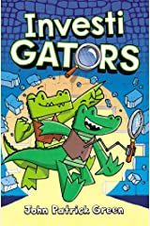
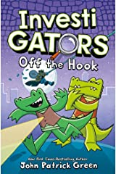
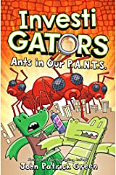
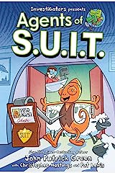
G – John Patrick Green
John Patrick Green, a talented author and illustrator, captivates young readers with his delightful and imaginative stories. His books are filled with vibrant illustrations and engaging plots that spark curiosity and wonder. Green's captivating storytelling and relatable characters create an enjoyable reading experience for children. Through his works, he encourages a love for reading and inspires young minds to explore their creativity.

Slide 22



G – John Patrick Green
Extract

Slide 23



G – John Patrick Green
Similar Authors
Phil
Corbett
Aaron
Blabey
Dav
Pilkey

Slide 24





H – Sophy Henn
Sophy Henn weaves heart-warming and enchanting stories for young readers. Her books are beautifully brought to life through her captivating illustrations and relatable characters. Henn's narratives embrace themes of friendship, self-discovery, and the power of imagination. Through her creative storytelling, she encourages young minds to embrace their uniqueness and explore the wonders of the world.

Slide 25
H – Sophy Henn
Hello!
My name is Jeanie and I am 7 ¾. I like badges, biscuits and cats that play pianos. But not always in that order. I have three very best friends. They are called Sukey, Marcy andWilf. I like them ALL totally equally so don’t even ask me who my best friend is (sometimes it’s Marcy but not all the time).
I like ALMOST everyone except Georgina Farquar-Haha and I don’t even really not want to like her, but she has made it impossible to.
I live here with my mum and dad and a whiney noise called Jack. Jack is SUPER annoying. His face is annoying, he smells annoying, his voice is very annoying and everything he says and does is annoying. I don’t really know what the point of him is. Except to annoy me. Which he is EXTREMELY good at.
Extract

Slide 26



H – Sophy Henn
Similar Authors
Pippa
Curnick
Samantha Baines
Paula Harrison

Slide 27




I – Iona Rangeley
Iona’s books will fill young readers with happiness and laughter. Lovable characters and stories that will keep you reading. Her books are made even better thanks to the masterful illustrations of David Tazzyman. Once you’ve read one, you’ll want to ppppppp... pick up the next (retro joke...)! They are perfect read alouds so that you can share the adventure and the giggles with family or friends.

Slide 28
I – Iona Rangeley
It was a very long time ago now, as long ago as last Christmas, that the Stewarts first met Einstein.
It was a cold sort of Christmas. The sort where days end early and forget to start on time, and the
fairy lights out in the street don’t quite make up for the darkness.
‘What can we do with the children?’ said Mrs Stewart to her husband one Saturday towards the
beginning of December. The early afternoon was bitterly chilly, and no one had found the heart to
venture out into it yet. ‘We don’t want them to get too bored. Imogen might paint the cat again.’
Mr Stewart sighed into his tea and turned a page of his newspaper. ‘She’s grown out of that sort of thing,
hasn’t she?’ ‘I don’t know,’ said Mrs Stewart. ‘Maybe.’ The children, at that precise moment in time, were
keeping themselves busy in the sitting room. Arthur, who was six, was drawing pictures in a notebook while
Imogen, his big sister, was sitting cross-legged in the corner, fiddling with the dials on a radio. Occasionally
it would make a crackling sound and then stop again, and she would triumphantly declare to her brother
that she had ‘fixed it’. ‘Maybe we should take them to the zoo!’ said Mrs Stewart suddenly.
‘The zoo?’ Mr Stewart repeated. ‘Yes!’ said Mrs Stewart, who had spotted an advertisement on the back of her husband’s newspaper. ‘Arthur might like to draw the animals!’ Mr Stewart frowned into the article he was reading. He rather liked the idea of going to the zoo. It was exciting: maybe he’d see a lion! ‘Well, all right,’ he said eventually, in a careful sort of voice. ‘If you think the children will enjoy it.’
Extract

Slide 29



I – Iona Rangeley
Similar Authors
Sam
Copeland
Swapna Haddow
Pip
Jones

Slide 30





J – Jamie Smart
Jamie Smart, a talented and imaginative author and illustrator, delights young readers with his quirky and humorous stories. His books are filled with vibrant and expressive illustrations that bring his characters to life. Smart's captivating storytelling and witty dialogue create an enjoyable and entertaining reading experience for children. Through his works, he encourages creativity and imagination, inspiring young minds to explore their own artistic talents.

Slide 31


J – Jamie Smart
Extract

Slide 32



J – Jamie Smart
Similar Authors
Neill Cameron
Joe Todd-Stanton
Mike Barfield & Jess Bradley

Slide 33





K – Jennifer Killick
Jennifer Killick, a gifted author, captivates young readers with her thrilling and suspenseful stories. Her books are filled with engaging plots and relatable characters that keep readers on the edge of their seats. Killick's skillful storytelling and clever twists create a sense of excitement and anticipation. Whilst her books for older children are known to be scary, her younger books are laugh out loud funny! Through her works, she encourages a love for reading and sparks curiosity in young minds.

Slide 34
K – Jennifer Killick
Have you ever wanted to be a secret agent? A bad A, undercover, villain-busting super spy, like Nick
Fury, the top dog at Marvel’s S.H.I.E.L.D. agency? Well, don’t get your hopes up – it takes a special
kind of person and years of training to get that job. I’ve been working on it since I was four and
up until a couple of months ago being accepted into S.H.I.E.L.D. still seemed a long way off. Sure,
you can do a hundred star jumps a day to make you strong, and keep chasing the scabby cat from
next door out of your garden to make you quick, but some spy skills are a bit harder to come by. For
example, how can you tell if someone is lying? People lie all the time. Especially grown-ups –
mums, dads, teachers – all of them. And I’m not just talking about the obvious lies, like pretending
the battery is dead when you’re stuck in a boring queue and want to play games on their iPhone, or
saying you did really well at sports day when you fell on your face and came last. No, this stuff goes
way deeper. Grown-ups tell lies that you would never guess about: not in a million years. Maybe
you’re thinking, ‘Well neither can you, bigmouth, so shut up and go back to your push-ups’. But I
actually can. You want to know how? It’s classified information, Top Secret Agent Business, but if you
promise to keep it to yourself, I’ll tell you First of all, let me explain how it started. I’m Alex, by the way, Alex Sparrow. I live at home with Mum, Dad, my little sister Lauren and our boring pet goldfish. I’m ten, in Year 6 at Cherry Tree Lane School. I’ve never minded school, and back then, when all this began, I was cruising
along nicely. I was pretty much the leader of my group of friends (all boys, no girls, obviously) and
we were really popular. Everyone wanted to hang around with us and people looked up to me, you
know? Life was awesome, or at least I thought so at the time, until one night, when everything changed…
Extract

Slide 35



K – Jennifer Killick
Similar Authors
Jack Meggit-Philips
Guy Bass
Lucy Noguera

Slide 36





L – Louie Stowell
Louie Stowell masterfully transports young readers to enchanting worlds with her captivating and imaginative stories. Her books are filled with magical adventures and lovable characters that ignite the spark of wonder. Stowell's skilled storytelling and compelling plots keep young minds eagerly turning pages. Through her works, she nurtures a love for reading and encourages children to embrace their creativity.

Slide 37
L – Louie Stowell
My name is Loki, and I am a god. Or I was until last Tuesday. Now, Odin has banished me to Earth in the form of an eleven-year-old boy. This situation is bad for many different reasons. First, there is the overall
weakness of this mortal body. I’m not the strongest of the gods, but right now, my legs look like sticks, and I have the upper-body strength of a small squirrel!
Gods spring into being fully formed, so I have not, until now, ever been a child. Apparently, this is what Odin thinks I would look like as one! Rude!
Second, there are my fake parents. The guard god Heimdall (who hates me) and a terrifying giant called Hyrrokkin (feelings unknown) are here to pretend to be my father and mother while we are on Earth. I have to live with them and do what they say. I am appalled at this indignity. I’m thousands of years old! I should not have a bedtime! I should not have to do chores! I should absolutely under no circumstances be expected to fold my own undergarments! Third, I must put up with elevenyear-old Thor, who seems to take great amusement from sitting on my head and farting. Perhaps I should take comfort in the fact that he is here and must suff er with me … but it’s hard to to be comforted at the same time you’re being farted on.
Extract

Slide 38



L – Louie Stowell
Similar Authors
Emer
Stamp
Jen
Carney
Andy
Riley

Slide 39





M – Harriet Muncaster
Harriet Muncaster, a talented and creative author-illustrator, delights young readers with her whimsical and enchanting stories. Her books are brought to life by her charming illustrations and relatable characters. Muncaster's imaginative storytelling and heartwarming themes create a captivating reading experience for children. Through her works, she sparks imagination and fosters a love for storytelling.

Slide 40

M – Harriet Muncaster
It was the first day of the summer holidays and Wilbur and I were feeling VERY excited. We were on our way to stay with our fairy grandparents—Granny and Grandpa Starspell! It was going to be the first time we had ever stayed at their house without Mum and Dad and it felt like an exciting adventure! Mum had even bought me a new pair of frogpatterned pyjamas for the occasion. They were folded up neatly in my suitcase which Dad was carrying in his hand as we flew through the sky towards Glimmerview Fairy Village. It was easier for Dad to carry both my and Wilbur’s suitcases as he is a full fairy and has wings! Wilbur and I didn’t inherit Dad’s fairy wings— we’re both more witchy like Mum, so we were both on our broomsticks instead.
Suitcases can be awkward to carry on broomsticks as they swing around a lot!
‘We’re almost there!’ said Dad excitedly as the clouds in the sky began to turn a fluffy pink colour like candyfloss and the roads below became empty of cars. Cars are not allowed in Glimmerview Fairy Village. ‘Oh look!’ cried Dad. ‘There’s the stream! I used to have such fun playing in the stream with my fairy friends when I was a boy. Well-behaved fun of course! We made flower garlands for each other, picked delicious fresh wild fruit, and had swimming races every day in the summer holidays. The sun was always shining. Oh, we did have such marvellous times! It was absolutely idyllic!’
Extract

Slide 41



M – Harriet Muncaster
Similar Authors
Michelle Harrison
Kirsty Applebaum
Hannah Peck

Slide 42





N – Nadia Shireen
Nadia Shireen, a gifted author and illustrator, captivates young readers with her heartwarming and delightful stories. Her books are brought to life with her vibrant and expressive illustrations, adding an extra layer of magic to her tales. Shireen's engaging storytelling and lovable characters create an enchanting reading experience for children. Through her works, she imparts valuable life lessons about friendship, kindness, and embracing one's uniqueness.

Slide 43
N – Nadia Shireen
Like a lot of foxes, they lived in a big city. Nancy was the bravest and boldest fox Ted had ever known. He couldn’t remember having a mum or a dad, but he had always had Nancy. She made sure he had food and somewhere warm to sleep. As well as looking after Ted, Nancy liked to mooch around the city with her friends. She knew every street, every dark alley, every bin and every hiding place. Nancy was TOUGH. She had no time for laughing or sniffing flowers or reading comics. But Nancy didn’t need those things, oh no. Ted, on the other hand, was a sweet little fox cub. He liked staying close to the den, which was hidden inside some spiky holly bushes in the corner of a huge park. Ted liked to roll around on the grass in the sunshine, snuffle through twigs and leaves, and lick up dropped ice-cream cones. Every now and then Nancy would trot by and drop off a snack for him.
Nancy preferred coffee. It kept her alert. Though sometimes, if she drank too much, she would shake and bark and Ted would have to sit on her head to calm her down. ‘Chill out, Nancy.' ‘Thanks, bro.’ Yes, Ted and Nancy were a great pair of foxes, and they had everything they needed. Well, almost everything. Lately, Ted had noticed a weird, achy feeling in his chest. He had it whenever he watched Nancy trot away, leaving him alone in the den. He had it when he saw her chatting with her fox friends, Bin and Hedge. He had it when he saw the cute little humans in the park holding hands with their big humans. Sometimes he would have it at night, when he would sit on top of a large rock, look up at the big, dark sky and give a heavy sigh.
Extract

Slide 44



N – Nadia Shireen
Similar Authors
Anna
James
Julian
Gough
Alex
Milway

Slide 45





O – Mo O’Hara
Mo O'Hara, a talented and humorous author, tickles young readers' funny bones with her witty and entertaining stories. Her books are filled with laugh-out-loud moments and lovable characters that children adore. O'Hara's engaging storytelling and clever plots keep readers eagerly turning pages. Through her works, she encourages a love for reading and inspires young minds to embrace their creativity.

Slide 46
O – Mo O’Hara
The sun was beginning to warm the air in the little garden by the cottage. Honey buzzed around the flowerpots next to the hive, her stripy fuzz all blown about and her wonky antennae twitching with excitement. ‘Major Honey to Ground Control. It looks like a rocky entry, but don’t worry, danger is my middle name,’ Honey shouted into an imaginary walkie talkie. ‘Over and out.’ I should explain. Honey’s middle name was not actually ‘Danger.’ She didn’t even have a middle name. Most bees don’t. And she was not in any real danger either. There isn’t much danger you can get into when you’re flying around two feet off the ground.
But Honey liked to be a little . . . well . . . dramatic. She was supposed to be practising her flower landings for Bee School, but Honey was putting it off. Procrastinating. And she knew exactly what that word meant because someone was always telling Honey that she was procrastinating. Pretty much every day. Sometimes, when Honey was supposed to be studying hive history, really she would be imagining herself as the queen of an ancient Egyptian beehive.
Sometimes, when she was supposed to be learning an important waggle dance, really she would be imagining that she was twirling pirouettes like a swooping swarm of swallows. Today she was supposed to be practising how to land on a flower head to collect pollen (a fairly essential life skill for a bee) but instead she was picturing herself as the first bee to land on the moon. ‘Shhhiss.’ Honey made her voice sound like an astronaut speaking through a space helmet. ‘One small step for a bee. One giant leap for bee-kind.’
Extract

Slide 47



O – Mo O’Hara
Similar Authors
Ben
Clanton
Pip
Bird
Thomas Flintham

Slide 48





P – Tom Percival
Tom Percival, a gifted author and illustrator, enchants young readers with his heart-warming and imaginative stories. His books are brought to life by his beautiful and expressive illustrations that add depth and emotion to his narratives. Percival's storytelling resonates with readers, touching on important themes of empathy, friendship, and self-discovery. Through his works, he encourages young minds to embrace their emotions and celebrate their uniqueness. Tom Percival's contributions to children's literature have earned him a special place in the hearts of young readers.

Slide 49

P – Tom Percival
Erika swam upwards through a cloud that smelled strongly of marshmallows. She glanced over at Beastling, swimming along beside her. He smiled and mumbled, ‘Heebie Jeebie,’ through the thickening cloud.
As he spoke, a speech bubble popped out of his mouth showing a picture of a thumbs up and a smiley face. Erika looked down at her timer. Twenty-five seconds. That was all they had before the cloud turned into a marshmallow and plunged to the ground in a deadly (but completely delicious) mess. This was not something that Erika wanted to happen – at least not with them still inside the clous!
BZZZZZT!
Erika’s communication device buzzed and a gravelly voice spoke. ‘Hey, Erika. Listen, while you’re back at Head Quarters getting that truth cannon, can you bring me a couple of doughnuts please?’
Extract

Slide 50


P – Tom Percival
Similar Authors
Sam
Copeland
Rachel Delahaye
Chris Callaghan

Slide 51




Q – Onjali Q Rauf
Onjali Q. Raúf tells powerful stories that touch the hearts of young readers. Her books tackle important social issues with grace and sensitivity, promoting empathy and understanding. Raúf's characters embark on journeys of courage and compassion, inspiring young minds to make a difference in the world. Through her compelling narratives, she sheds light on the strength of unity and the importance of standing up for what is right. Onjali Q. Raúf's works serve as a beacon of hope and change, making her a cherished voice in contemporary children's literature.

Slide 52
Q – Onjali Q Rauf
‘HECTOOOOOOOOORRRRRRRGGGGGH! STOP RIGHT THERE!’ I froze with my hand hovering above the large vat of bright red tomato soup. It would have been a perfectly ordinary pot of soup, if it hadn’t been for the long, bright green rubber snake that was now floating around right in the middle of it. ‘HECTOOOOORRR! I’M WARNING YOU!’ I slowly turned to look over my shoulder. I could see all the dinner ladies in their bright blue uniforms staring at me with their mouths wide open, like doors someone had forgot to shut. Everyone in the dinner hall had frozen. Except for Mr Lancaster. His mouth was open wide too, and getting wider like a big black hole. 2 I could tell he was getting ready to explode because his face had gone as pink as a baboon’s bottom, and his nose was starting to twitch. ‘Don’t you dare,’ he hissed, glaring at the second rubber snake I was holding in my hand. I looked down at the second snake. This one was bright red. Almost as bright red as the boring soup Mrs Baxter had made. I knew I had two options. The first one was to not drop the second snake in. I would still get punished for the green snake, but maybe it wouldn’t be quite as bad. The second option was to drop the snake in. That would make Mr Lancaster even madder than he already was and make Mrs Baxter really mad. But it would serve her right for being the worst dinner lady we’d ever had – always narrowing her eyes and giving us the smallest spoonfuls of the things we wanted, and plonking giant spoonfuls of the things we hated on to our plates. It was about time someone got her back. Plus it would make Will and Katie, my two best friends, laugh.
Extract

Slide 53



Q – Onjali Q Rauf
Similar Authors
Peter
Brown
Katherine Applegate
Nizrana Farook

Slide 54





R – Philip Reeve
& Sarah
McIntyre
Philip Reeve and Sarah McIntyre are a dynamic duo, combining their talents to create enchanting and whimsical stories for young readers. Their books are a delightful blend of Reeve's captivating storytelling and McIntyre's charming illustrations, making for an engaging and immersive reading experience. Together, they take readers on exciting adventures in imaginative worlds, filled with lovable characters and captivating plots.

Slide 55


R – Philip Reeve
& Sarah
McIntyre
Extract

Slide 56



R – Philip Reeve
& Sarah
McIntyre
Similar Authors
Rob Biddulph
Elaine Wickson
Andy Griffiths

Slide 57





S – Serena Patel
Serena Patel captivates young readers with her enchanting and adventurous stories. Her books take readers on thrilling journeys with Anisha and her friends as they crack mysterious cases. Her works shine with diverse representation and relatable characters, inspiring curiosity and creativity in children. Through her engaging storytelling, she fosters a love for reading and promotes cultural diversity.

Slide 58
S – Serena Patel
“No, no, no, this is terrible! I said pink carnations. If I wanted red ones, I would have asked for red ones!” yells my Aunty Bindi. She’s making a right racket. Her fists are clenched and her face is turning a funny purply colour – I’m a bit worried that her head might actually erupt in a big purple slime explosion as she screams at the flower delivery man. This is already the third time she’s sent the poor man back and he looks like he’s going to cry. I slump in the chair and bury my head in my book, Life, the Universe and Everything, to try to shut out the noise. I just wish I could get some peace and quiet around here. Dad says I should be reading “more appropriate books for girls my age”. I’m not sure what kind of books those are, but I like reading about time, space and numbers. Numbers are great, they make sense – unlike people. You’d think this too if you lived with my family. The delivery man apologizes like his life depends on it. “I’m so sorry, madam. I just deliver the flowers, as I explained before. Perhaps you should ring the shop and tell them exactly what you want.” “I DID tell them. It’s not rocket science, is it? I want my flowers and I want them pink. Is that too much to ask?” And with that, she slams the front door so hard that it bounces back and hits her in the face. “Aunty, this is just a suggestion, but maybe you should calm down. Getting stressed isn’t good for your health,” I say, as I watch her rubbing her nose. Mum says these kinds of helpful things to my dad all the time. He gets stressed out too – not by flowers but by his job as a lawyer for Bundi, Bandu and Bhaskar LLP. I’m not sure exactly what he does, but it seems to involve going all red in the face and shouting down the phone a lot. When I grow up, I’m going to work in a lab where it’s clean and quiet and I don’t have to see a lot of people. That would be my number-one dream job. “This wedding is going to be a disaster, a firstclass disaster!” Aunty Bindi wails. She’s been speaking all high-pitched like this ever since she started planning her wedding. THE WEDDING OF THE YEAR! The wedding that is happening TOMORROW. She’s marrying her “sweetie pie”. (That’s what she calls him – urgh!) His real name is Tarnvir, except only his mum calls him that.
Extract

Slide 59



S – Serena Patel
Similar Authors
Sophie
Deen
Harriet Whitehorn
Polly
Ho-Yen

Slide 60





T – Sarah Todd Taylor
Sarah Todd Taylo rweaves mesmerizing mystery stories that ignite the imagination ofher young readers. Her books lead audiences on thrilling adventures, filled with captivating twists and turns. Taylor's relatable characters grapple with courage and friendship, imparting valuable life lessons. Her series will leave readers desperate to get their hands on the next book.

Slide 61
T – Sarah Todd Taylor
Alice stared at the Eiffel Tower and dared herself to add more fireworks. There is always room for improvement, she thought She had spent all morning crafting icing into the city's most famous landmark for the top of an anniversary cake. Sugar strands criss-crossed one another in a perfect replica of the tower's girders. She had made the viewing platform in paper-thin sheets of caramel and added icing miniatures of the bride and groom, with the swirls on the woman's dress picked out in silver. It was gorgeous.
But not gorgeous enough for Alice. She had added spun-sugar orbs to look like fireworks exploding from the top of the tower, and now she decided that she could top even this!
Alice cupped the icing bag in one hand and leaned in close to one of the orbs of whisper-thin sugar strands. She held her breath and placed a small dot of glistening white icing on an individual strand. She gave a light twist and left a single star hanging from the wisp of sugar. Alice worked quickly, adding more stars here and there, till she was sure she had just the effect she wanted. She reached down to her worktop, took a pinch of sparkling sugar dust, and sprinkled it lightly over the wet icing stars She stood back. Now it was perfect.
Alice looked across the shop to where her mother was packaging up biscuits for one of Paris's most exclusive hotels, a regular order for their famous pâtisserie, Vive Comme L'Éclair.
"It's done, Maman," she said.
Extract

Slide 62



T – Sarah Todd Taylor
Similar Authors
Lee
Newbery
Jennifer
Bell
Megan
Rix

Slide 63
U – urm.... sorry

Slide 64





V – Vashti Hardy
Vashti Hardy enchants young readers with her imaginative and adventurous stories. Her books transport audiences to extraordinary worlds, filled with wonder and magic. Hardy's relatable characters embark on thrilling quests, teaching valuable lessons about courage and resilience. Through her engaging storytelling, she sparks curiosity and a love for exploration in children. Vashti Hardy's works inspire young minds to believe in themselves and embrace their creativity.

Slide 65
V – Vashti Hardy
Harley ran up the lane towards Cogworks, puffing like the Inventia Express. The school was located at the top of a hill, which was not a good thing when you were late. Sprocket, her robot dog, zoomed ahead. He was twice as fast as her, having been fitted with turbo legs only a month ago. “Wait for me!” she called. He stopped and tilted his head, as though to say, “Is everything all right?” She’d been hoping to get a turbocharged boost to school this term by putting wheels on her boots and attaching a lead to Sprocket, but the first time she had tried it, the little robot’s circuits overloaded and sparks flew. She’d mended his legs but didn’t want to risk damaging him again. Harley glanced up at Cogworks. The morning sun glinted on the twisting steel pipes, the great domed roof and tall, layered towers of the classroom and laboratory block.
The enormous cog clock above the entrance read one minute to nine – she would just make it. As she ran, Fenelda Spiggot’s familiar smug pose, silhouetted in one of the windows, caught her attention: hands on hips and sharply cut bobbed hair. Harley grimaced and charged onwards, hoping Fenelda hadn’t spotted her. But as she approached the school gates, a loud roar erupted behind her, along with the frantic honk of a horn. Just in time, Harley looked over her shoulder to see a shiny silver transporter heading straight towards her. “Out of the way!” someone called from inside the vehicle. Harley had no choice but to leap into the bank of thistles at the side of the lane. The transporter whooshed past, spraying dirt as it made its way through the gates into the Cogworks grounds. Harley groaned. The driver had clearly seen her yet had expected her to jump out of the way! Now not only was she late, she was also covered in dirt. Her temper began rolling like a small thunderstorm in her chest. This wasn’t a good start to the day.
Extract

Slide 66



V – Vashti Hardy
Similar Authors
Maz
Evans
Lucy
Brandt
Santa & Simon Sebag Montefiore

Slide 67




W – Bethany Walker
Bethany Walker uses her brilliant sense of humour to captivates young readers with her whimsical and witty tales. Her books are filled with laugh-out-loud moments and lovable characters that children adore. Her books are illustrated perfectly by Jack Noel and they will bring just as many giggles as the words themselves!

Slide 68
W – Bethany Walker
Dear Mum and Dad,
Have you arrived in Outer Castonga yet? I hope your journey went well. I’m still GUTTED that I couldn’t come with you – are you ABSOLUTELY sure I can’t join you? It sucks that you’ve had to go away so soon after we’ve moved here. And who cares about farming sprouts? I mean, what’s the worst that could happen: no sprouts? I wish you were still cabbage farming in Norfolk – at least then we were all together. And why did you have to go away during the Easter holidays? There’s NO ONE around to play with. You remember Ajay Coppertoe? Like us, he’s only just moved here and we started school at the same time? Well, Ajay is the one friend I’ve made since we moved here and he’s on holiday with his dad, so the only person I’ve got to hang out with is Grandad. It’s really boring. I’ve been working hard on my Easter project. It was so nice of Lamont Riley to tell me about it. Lamont normally barely speaks to me. I can’t believe I missed Mr Norbert’s announcement to the class about the Easter project when I went off to the loo. Lamont went out of his way to tell me all about the project. So nice of him! A 5,000 word essay on the history of pencils seems like a strange project to set – and it doesn’t link with anything we’ve been learning at school – but at least it’s something to do! At EVERY meal, Grandad is feeding me sprouts. YUCK! Just because we get them free! I know you said, “A day without sprouts is a day without sunshine,” but I’d be quite happy with a gazillion days of rain if it meant I didn’t have to eat sprouts! Better go. It’s time for my chocolate milk. But Grandad always stirs the powder in. It’s sooooo much better how you do it – shaken, not stirred.
Love Freddy
Extract

Slide 69



W – Bethany Walker
Similar Authors
Katie & Kevin
Tsang
Josh
Lacey
Jack
Noel

Slide 70





X – AleX T Smith
Alex T. Smith captivates young readers with his whimsical and endearing stories. His books are brought to life by his delightful and expressive illustrations, adding an extra layer of magic to his tales. Smith's engaging storytelling and lovable characters create an enchanting reading experience for children. Through his works, he imparts valuable life lessons about friendship, kindness, and celebrating our differences.

Slide 71


X – AleX T Smith
Extract

Slide 72



X – AleX T Smith
Similar Authors
Nick
East
Philip
Ardagh
Emma
Read

Slide 73





Y – AndY Stanton
Andy Stanton, a master of humor and wit, delights young readers with his hilarious and imaginative stories. His books are filled with laugh-out-loud moments and quirky characters that children adore. Andy Stanton will whisk you away on a rollercoaster of hilarity and wonder. So, dear reader, fasten your seatbelts and get ready for a wild and wacky adventure through the pages of his books - a joyful ride that will leave you grinning from ear to ear!

Slide 74
Y – AndY Stanton
Mr Gum was a fierce old man with a red beard and two bloodshot eyes that stared out at you like an octopus curled up in a bad cave. He was a complete horror who hated children, animals, fun and corn on the cob. What he liked was snoozing in bed all day, being lonely and scowling at things.
He slept and scowled and picked his nose and ate it. Most of the townsfolk of Lamonic Bibber avoided him and the children were terrified of him. Their mothers would say, 'Go to bed when I tell you to or Mr Gum will come and shout at your toys and leave slime on your books!' That usually did the trick.
Mr Gum lived in a great big house in the middle of town. Actually it wasn't that great, because he had turned it into a disgusting pigsty.
The rooms were filled with junk and pizza boxes. Empty milk bottles lay around like wounded soldiers in a war against milk, and there were old newspapers from years and years ago with headlines like
VIKINGS INVADE BRITAIN
and
WORLD'S FIRST NEWSPAPER INVENTED TODAY.
Insects lived in the kitchen cupboards, not just small insects but great big ones with faces and names and jobs.
Mr Gum's bedroom was absolutely grimsters. The wardrobe contained so much mould and old cheese that there was hardly any room for his moth-eaten clothes, and the bed was never made. (I don't mean that the duvet was never put back on the bed, I mean the bed had never even been MADE. Mr Gum hadn't gone to the bother of assembling it.
Extract

Slide 75



Y – AndY Stanton
Similar Authors
John Dougherty
Pamela Butchart
Simon Farnaby

Slide 76





Z – Zanib Mian
Step into the captivating world of Zanib Mian, where magic and imagination know no bounds! With her enchanting stories and relatable characters, she takes young readers on unforgettable adventures. Mian's tales are brimming with heart and wisdom, imparting valuable life lessons about empathy, resilience, and the power of kindness. Through her skilful storytelling, she sparks curiosity and ignites a love for reading in young minds.

Slide 77



Z – Zanib Mian
Extract

Slide 78



Z – Zanib Mian
Similar Authors
Gabrielle Kent
Serena Holly
Atinuke

