Slide 1




Welcome to
Year 4
Class of 2025-2026
Meet the Year 4 Team:
Class Teacher- Mrs Benita De Sousa
Teaching Assistant – Mrs Creech
PE Coach: Mr Prower

Slide 2


Working in partnership
“Let all that you do be done in love”
1 Corinthians 16:14
We act with love, build our faith and grow as people.

Slide 3
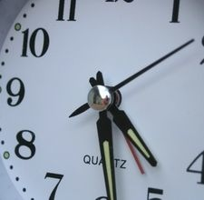
Breakfast Club starts: 7.45am
Drop off at the gates: 8.35am
Gates close: 8:45am
Registration: 8.50am
Register closes: 9.00am
Lunchtime starts: 12.30pm
Lunchtime finishes: 1.30pm
School finishes: 3.15pm
Clubs after school: 3.15-4.15pm
Splatz: 3.15- 6pm
Be on time! Even being just a few minutes late can get a child’s day off to a bad start.
During the first 10 or 15 minutes of the school day, children give in letters, choose lunch, organise their belongings, do their early work tasks.
Being 10 minutes late a few times a week adds up to 50 minutes – the length of an average English or Maths lesson.

Slide 4
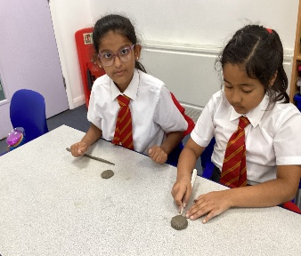
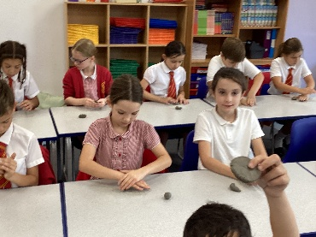
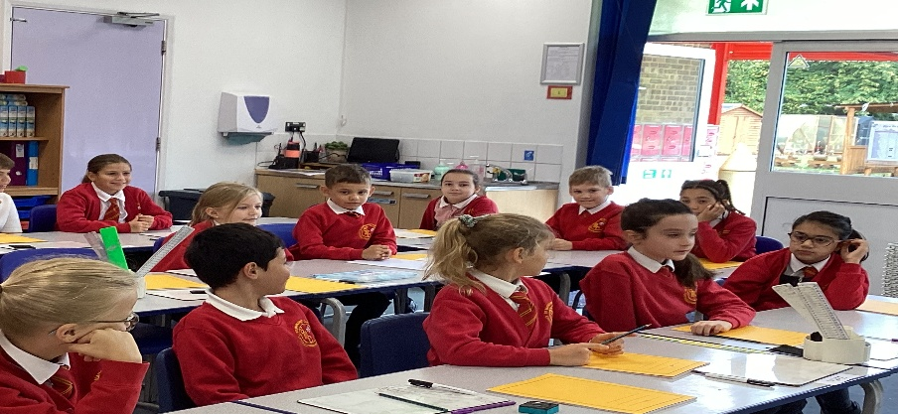
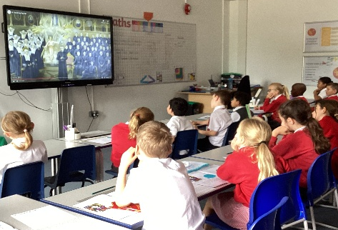
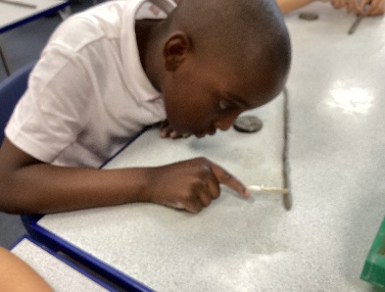
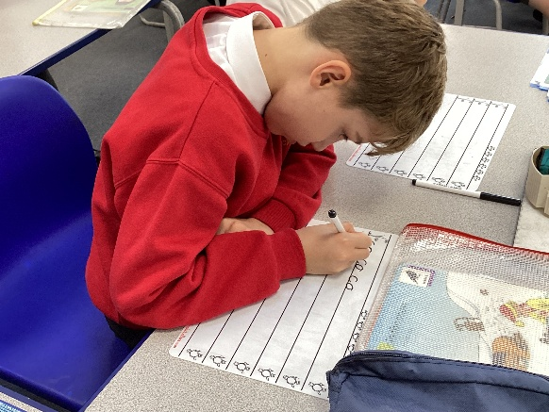
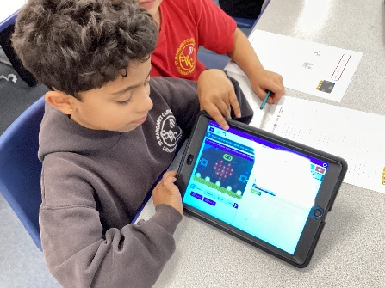
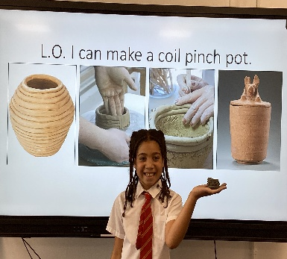
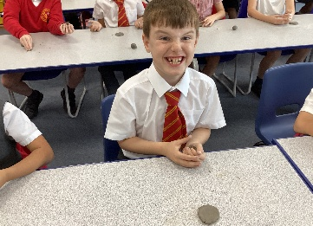
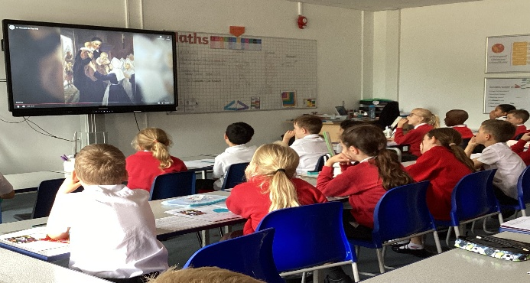
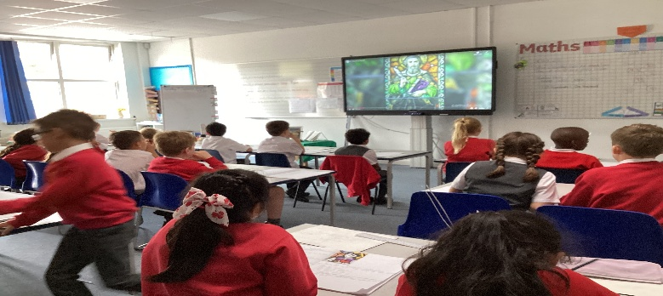
Learning in Action So far!

Slide 5

We want to know:
Inform us of any issues arising
Send an email to:
secretary@smc-brackell.com

Slide 6

IMPORTANT NOTE:
Issues which arise in school should be dealt with in school by the school.
Please do not approach other parents or children about incidents which have occurred in school, even if you know them well.

Slide 7

Social Media
We have an open door policy. If you have any concerns about the school or your child, please tell us directly.
Social media, or the playground, is not an appropriate forum to discuss issues concerning your children: it can often compound a problem and in our experience it is never part of the solution.

Slide 8
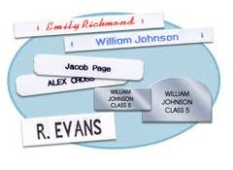
Uniform and Belongings
Your child is responsible for their own belongings.
The best way to support your child in doing this is to
ensure that every item brought into school is clearly
labelled.
Water bottles should be brought into school every day
( with just water please).

Slide 9
Our P.E. Days:
Scheduled for Mon & Wed.
All kits to be in school on Monday and kits brought home on Thursday.
All children to wear their PE kits on Friday
for Fit Friday.

Slide 10
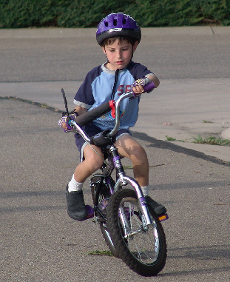
Independence
Pack / empty own bag.
Filling own water bottle.
Take responsibility for letters.
Taking care of own belongings.
Labelling own belongings.
Doing homework without reminders.
Completing homework tasks independently – nothing new is set for homework, it is consolidation of class learning.

Slide 11
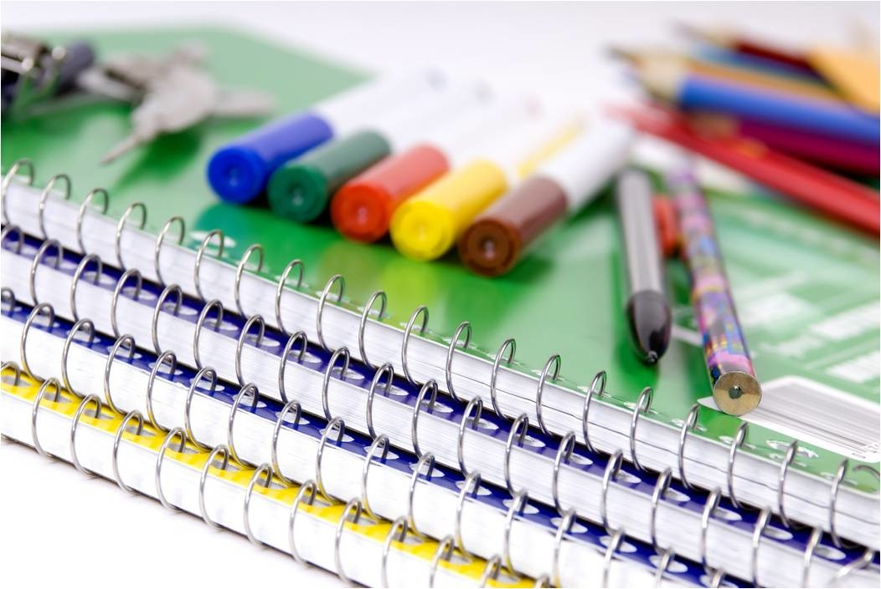
Learning equipment
Please could your child bring in a small labelled pencil case
Items that would be very useful for your child :
pencils
a sharpener
a rubber (Art)
coloured pencils
whiteboard pen
Ruler
Glue stick
Please ensure all items are labelled.

Slide 12
St Margaret Clitherow School Rules
Follow
Follow instructions given by all adults in the school
Keep
Keep hands, feet and objects to yourself
Treat
Treat equipment sensibly
Show
Show respect to all members of our school community
Listen
Listen carefully and respond appropriately

Slide 13

Success today at SMC!
6 Huge Achievement
5 Excellent today
4 Feeling proud
3 Successful day
2 Well done
1 Great start

Slide 14
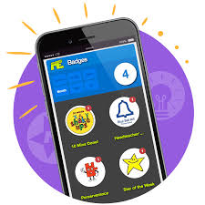
Rewards using Marvellous Me!

Slide 15
Bullying is never ok and always needs to be addressed
But bullying is not…
Not liking someone.
Being excluded.
Accidentally bumping into someone.
Wanting to play a game their way.
A single act of telling a joke about someone.
Arguing.
Isolated incidents of unpleasantness, aggression or meanness.
However, all of these would be taken seriously and discussed as a learning point with your children.

Slide 16
There is no legal definition of bullying. However, it’s usually defined as behaviour that is:
Repeated
Intended to hurt someone either physically or emotionally.
Often aimed at certain groups, e.g. because of race, religion, gender or sexual orientation.
It takes many forms and can include:
Physical assault
Teasing
Making threats
Name calling
Cyber bullying - bullying via mobile phone or online (e.g. email, social networks and instant messenger)
Our anti-bullying policy is on the school website.

Slide 17
Places, partners and groups
Children will learn independently, in pairs and in groups.
Children’s places and groups will change regularly, according to learning styles, ability, social groups.
Children will work in several different groups over the course of a week.

Slide 18

Progress for every child
Work aims to be at correct level of challenge for each child.
TA, SENCo or Class Teacher guided sessions.
Additional support or challenge.
Learning with others at similar level.
Learning with others at different levels.
Paired work.
Same task, different expectations.
Same objective, different task.
Different objective, different task.

Slide 19
Expected Progress in Year 4
Milestones have been set in order to ensure sufficient progress throughout the year.
Children making a slower rate of progress or who are at risk of not meeting their personal target are monitored closely, with various booster sessions and personalised tasks.
Children who are making accelerated progress are given opportunities to complete tasks which reflect their ability, with support as needed.

Slide 20
History/Geography Topics in Year 4
Geography:
What are the similarities between my region and Campania, Italy?
Locality
Weather
History:
What are the greatest achievements of Ancient Greece?

Slide 21
Topics continued:
Science:
Animals including humans – Teeth and the Digestive system
Electricity
Sound
States of Matter
Living things and their habitats
Art & DT
Sculpture, Chromatic, Monochromatic art.
DT: Food – chocolate that cares
Textiles- Bag a story.
Construction – Roman Innovations

Slide 22

English writing
Place value of Punctuation and Grammar.
Extinct animals (Non-chronological report)
Charlie and the Chocolate factory (recount diary entry)
Wonka World (Setting descriptions)
Ancient Greek Mythological Monsters (Non-chronological report)
How to slay a Minotaur (Instruction writing)
How does the Digestive System work? (Explanation)
Poetry
Escaping Pompeii (Narrative: characterising speech)
Boudicca Rallies Support (Persuasive letter)
The Legend of Robin Hood ( Narrative)
Does the Sound get quieter as the distance increases? (Science experiment)

Slide 23
Mathematics
Number place value
Addition and subtraction
Measure
Length and perimeter
Multiplication and division
Fraction
Money
Decimals
Time
Shape
Position and direction
Summer Term
MTC Assessment commences 1st June – 12th June 2026.

Slide 24
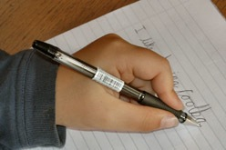
Handwriting
All handwriting MUST be joined and using a cursive style.
We practice regularly in school.
Please encourage your child to carefully join their writing when completing their homework tasks.
Please check your pack for an example of letter formation.
Some children will join a handwriting intervention with the class TA to support handwriting, but any support from home is always welcome.

Slide 25
Multiplication Check Year 4
As per the National curriculum, Times tables is a huge focus In Year 4 . All children will be required to sit the Multiplication Times tables check assessment in the Summer term, scheduled for 1st June to 12th June 2026.
I will have a meeting closer to the time to check in, support and update you on any updates.
However, practicing from now for 5 minutes per night playing Garage on TTRS, will really give your child a good head start.
Please encourage your child to use the TTRS website to practice their times tables daily. A really good tool is the Sound Check game which mirrors the real check with random 25 questions based on a 6 second time limit per question.
Most importantly – we do not want the children to stress about this, so our approach through fun games on TT Rockstars and multiplication songs in class, enables learning through FUN and practice.

Slide 26
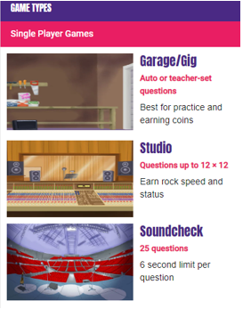

Slide 27
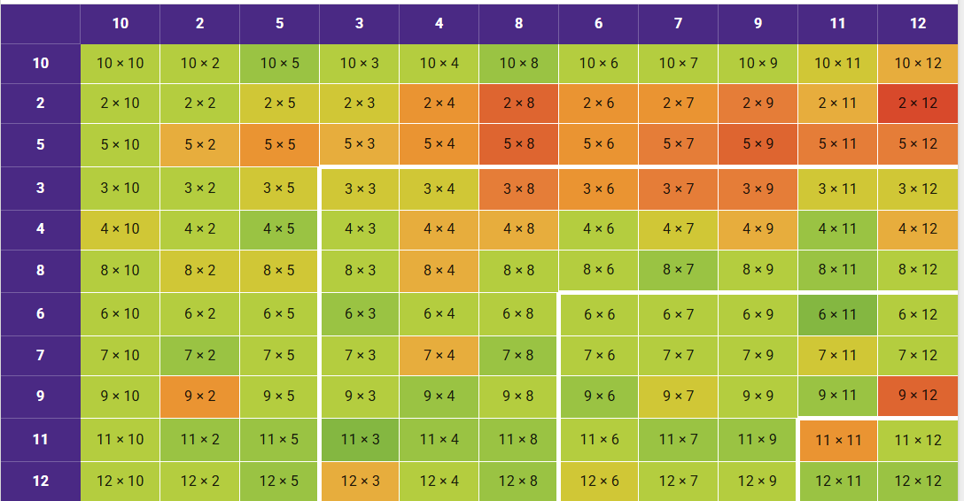

Slide 28


Reading
Please ensure that your child reads daily and you hear your child read aloud – aim for 10mins each day.
Reading is not just about de-coding. Ask your child questions which require them to make inferences and deduction from the text – in other words, can they read between the lines?
This supports their reading comprehension, builds their vocabulary, inference, prediction, explanation, retrieval, sequencing and summarising skills.
We use Reading plus as our Reading intervention to support our students to further develop their reading skills.
Remember reading should be FUN to develop children’s interest in a love for reading ☺

Slide 29
Purpose of Homework
Consolidates recent taught work
Reinforces basics
Informs future planning
Supports independent learning
Provides a dialogue about learning between child, parent and teacher
Celebrates success

Slide 30
Getting Homework
Given out on a Thursday due byTuesday
Tasks are explained during lessons and examples worked through where necessary.
Any problems, please see me or send a quick email ahead of when it is due!
ALL children are expected to complete all homework set.

Slide 31
Homework in Year 4
Daily Reading with your child is essential in developing their reading skills as it filters into all their learning. 10 mins daily reading: please put the page number they read up to, date, sign and include a comment and any difficulties your child may have had and or comments on how they are enjoying the text read so far. Are they able to answer questions relating to the text? This helps us support their reading skills further in class and enhances reading comprehension. We are currently Benchmarking all the children to check reading levels.
Daily TT Rock stars min 5 minutes practice to support Timetables fluency, children are encouraged to do a ‘Soundcheck’ per day.
Spellings These will be available on EdShed/Spelling Shed.

Slide 32
Feedback for Homework.
Marvellous Me House points are used to reward exceptional effort in homework.
Homework often forms part of a display. Feedback for these tasks may be verbal.
Tasks should be completed independently. If a lot of support is needed, please do let me know.
Please do not spend excessive time on homework (20 mins per piece is a guide – family life comes first!)
When in doubt work on the Times tables, reading and the spellings as these are a priority.

Slide 33

Medication
Please see the office for a medical form if your child requires any form of medication.
Following instruction from the completed medical form, we will administer and record this on Medical Tracker.

Slide 34
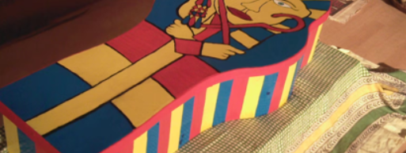

Trips 2025-26
We are off to Ufton Court
Date 19th March 2026.
Cost £35-40 (Spring Term)
Wilde Week at South Hill Park, 9th July 2026 - cost of £10 approx. (Summer term)

Slide 35
Save the dates!
Upcoming Parents Evening:
on
Wednesday 12th November 2025,
from 1:30 – 7:00pm.
Wednesday 4th March 2026
1:30 – 7:00pm.

Slide 36

There will be individual parent appointments in a few weeks.
Please make an appointment to see me at any time should the need arise.
Don’t wait if you have a concern!
Any questions?
Thank you for coming and thank you for your continued support with your child’s learning.

