Slide 1
A-Z of Authors
Year 5 & 6

Slide 2
A
B
C
D
E
F
G
H
I
J
K
L
M
N
O
P
Q
R
S
T
U
V
W
X
Y
Z

Slide 3
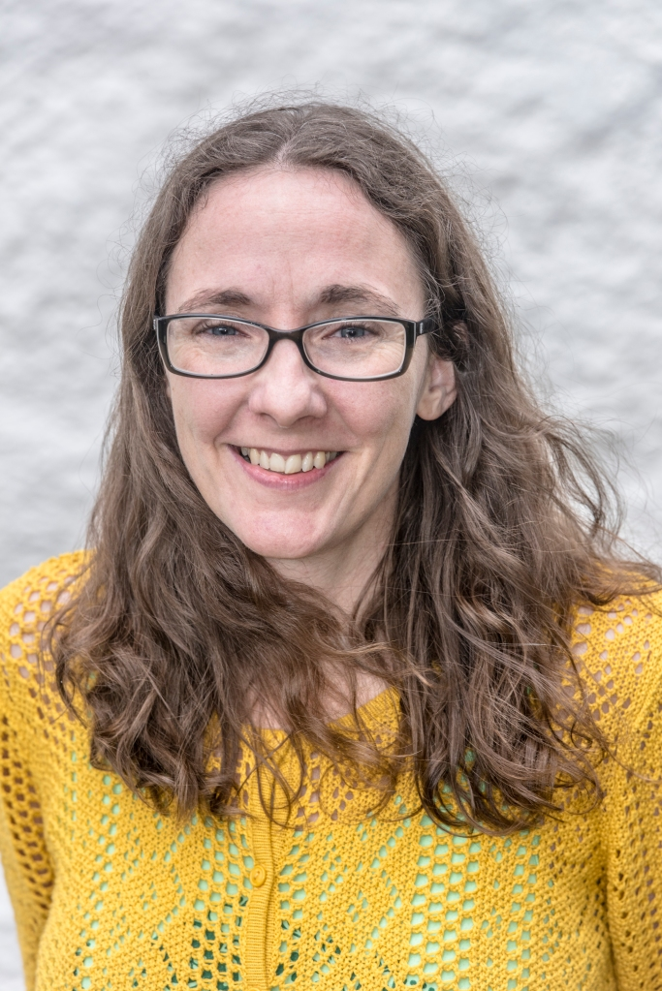
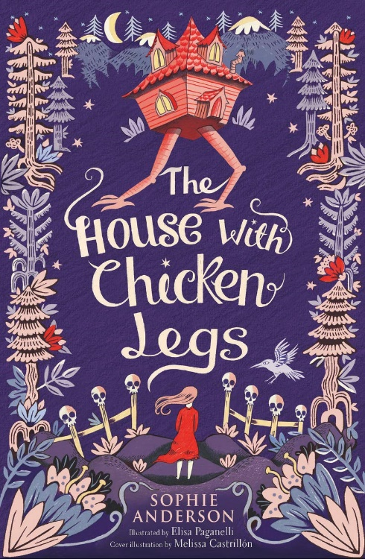
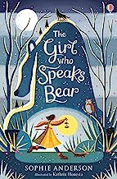
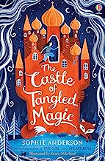
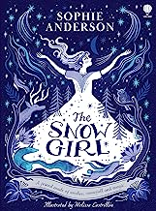
A – Sophie Anderson
Sophie Anderson is a master of captivating young minds through her enchanting tales. Specialising in the fantasy genre, she weaves magical worlds filled with mystical creatures and brave protagonists. Her books transport children to far-off lands where imagination knows no bounds. With a unique blend of folklore and original storytelling, Sophie's works inspire creativity and empathy in her young readers. Through her characters' adventures, children learn the importance of courage, friendship, and resilience. A must-read for any child, Sophie Anderson's books promise unforgettable journeys that instil a lifelong love for reading and the power of imagination.

Slide 4
A – Sophie Anderson
My house has chicken legs. Two or three times a year, without warning, it stands up in the middle of the night and walks away from where we’ve been living. It might walk a hundred miles or it might walk a thousand, but where it lands is always the same. A lonely, bleak place at the edge of civilization. It nestles in dark forbidden woods, rattles on windswept icy tundra, and hides in crumbling ruins at the far edge of cities. At this moment it’s perched on a rocky ledge high in some barren mountains. We’ve been here two weeks and I still haven’t seen anyone living. Dead people, I’ve seen plenty of those of course. They come to visit Baba and she guides them through The Gate. But the real, live, living people, they all stay in the town and villages far below us. Maybe if it was summer a few of them would wander up here, to picnic and look at the view. They might smile and say hello. Someone my own age might visit – maybe a whole group of children. They might stop near the stream and splash in the water to cool off. Perhaps they would invite me to join them. “How’s the fence coming?” Baba calls through the open window, pulling me from my daydream. “Nearly done.” I wedge another thigh bone into the low stone wall. Usually I sink the bones straight into the earth, but up here the ground is too rocky, so I built a knee-high stone wall all the way around the house, pushed the bones into it and balanced the skulls on top. But it keeps collapsing in the night. I don’t know if it’s the wind, or wild animals, or clumsy dead people, but every day we’ve been here I’ve had to rebuild a part of the fence. Baba says the fence is important to keep out the living and guide in the dead, but that’s not why I fix it. I like to work with the bones because my parents would have touched them once, long ago, when they built fences and guided the dead.
Extract

Slide 5
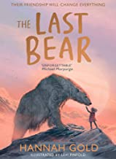
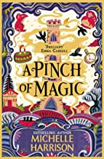
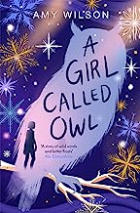
A – Sophie Anderson
Similar Authors
Hannah
Gold
Michelle
Harrison
Amy
Wilson

Slide 6
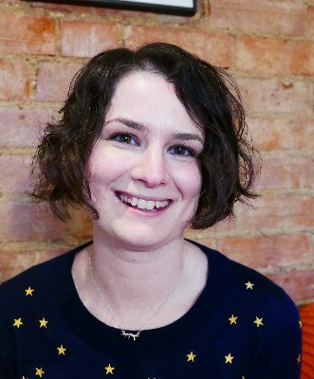
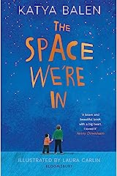
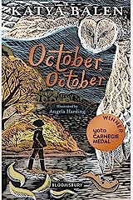
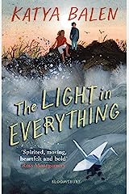
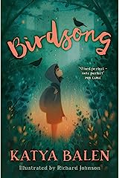
B – Katya Balen
Katya Balen crafts poignant stories that touch the hearts of young readers. Known for her exceptional talent in the contemporary children's fiction genre, Balen delves into sensitive themes with remarkable grace and insight. Her books tackle complex emotions and real-life challenges, allowing children to connect deeply with the characters and their journeys. Through her narratives, Balen encourages empathy, compassion, and understanding, fostering emotional intelligence in her young audience. With her compelling storytelling and relatable characters, Katya Balen's books serve as a guiding light for children, imparting valuable life lessons and showing the transformative power of resilience and hope.

Slide 7
B – Katya Balen
We find the owl at the very edge of our woods the morning after the storm. Wind-blasted and wings flight-frozen and round eyes glassy. I touch its feathers lightly with my fingertip and I’m surprised because they still feel real even though the owl has slipped away somewhere else and Dad is already digging a hole for it in the rain-soaked earth. I lift its body and it’s huge in my hands but the hollow bones do most of the work for me and I almost think the owl might shake the stiffness from its feathers and fly away. I sometimes see flashes of owls dipping through the trees. I hear them calling softly 2 like they’re singing night songs to each other and they’re beautiful, and like secrets wrapped up in the darkness. I really don’t think this one should go into a hole in the ground. I say that to Dad and he says that it’s the circle of life and that now the owl will become part of nature again. Rotting down to bones and feeding the soil with its flesh and growing the roots of plants from its feathers. I almost want to see it happening. Once I found the skeleton of a fox swirled into a circle of bones and scraps of fur. The sweep of its skull and the harp of its ribs were bone-white and beautiful. Dad shifts the last of the dirt with his spade and sits down at the base of a tree with a huff of air that smokes around him. I put the bird in the hole and mark the grave with a smooth pebble so I’ll always know. After we’ve buried the owl we walk all around the woods and clear the worst of the damage from the winds and the rain and a little tongue of lightning that has licked the old oak with the branches 3 that spread out like the tentacles of a giant squid. The damage isn’t as bad as it’s been before and it feels like the storm has cleaned everything back to being new and fresh. I use my hawk eyes and search the ground in flicks and sweeps and I find treasures in the rain-raked earth just like always.
Extract

Slide 8
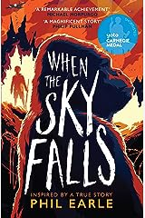
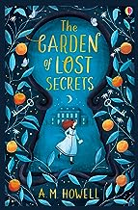
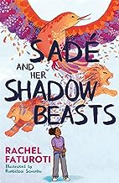
B – Katya Balen
Similar Authors
Phil
Earle
A.M
Howell
Rachel
Faturoti

Slide 9

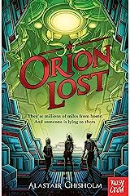
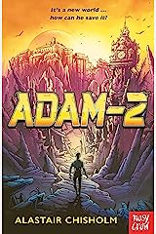
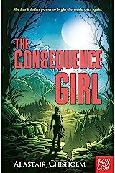
C – Alastair Chisholm
Alastair Chisholm, a gifted wordsmith, is a fantastic fantasy author. His ability to capture young readers' imaginations and keep them hooked from start to finish is truly remarkable. Through his engaging storytelling, Alastair transports children to extraordinary worlds, sparking their curiosity and encouraging a love for learning. Moreover, Chisholm's books often promote problem-solving, critical thinking, and teamwork, making them not only entertaining but also enriching. For any young reader seeking thrilling escapades and thought-provoking narratives, Alastair Chisholm's books are an absolute delight to explore.

Slide 10
C – Alastair Chisholm
There was a ship, in space, lost. It was a large, old, mining transport, designed for longhaul trips to small moons and asteroids. The enormous squat engines and hydrogen scoop underneath gave cheap and steady propulsion, but not much acceleration. The command module was small, but its cargo section was huge, taking up most of the ship. It was broadcasting a radio signal: —Earth ship Orion, four months out of Earth and heading for Eos Five. Our location is Sector 278. Coordinates 549 dash 2 by 902 dash 8 as of— An experienced miner might notice odd things about the ship. It had been patched and reftted, and its life support systems – gravity, oxygen, food processing – extended to cope with a much larger crew. Extra equipment was fastened round the hull, designed for planet exploration. Rovers, diggers, habitats, all with landing gear but no launch rockets of their own. They could land but they’d Prologue 2 never take of again. Not a mining transport any more then, but a colony ship, taking a group of brave new-worlders of to some distant settlement, and then staying to help them set up. —currently adrift, said the message, and we have no propulsion, although our Jump drive is functioning. Four large power generators bulged out near the base, but two of them were cold and dark and only a few of the ship’s outer lights were working. It was turning gently, and as it turned, it revealed an enormous scorched rupture near one of the engines. We have experienced severe damage to the ship. A ship in deep space hardly ever sent out a distress signal. What would be the point? Ships were like tiny motes of dust in the vast sky, so far apart that the chance of one coming across another by accident was efectively zero. Near Earth, or around the Solar System, sure, perhaps heading to one of the older and more established colonies, on a well-known route. But not out here. Here you could travel for six months and see no one, and no evidence that anyone else had ever existed.
Extract

Slide 11
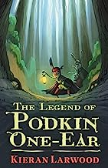
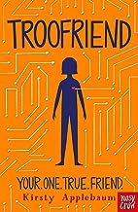
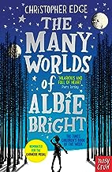
C – Alastair Chisholm
Similar Authors
Kieran
Larwood
Kirsty
Applebaum
Christopher
Edge

Slide 12
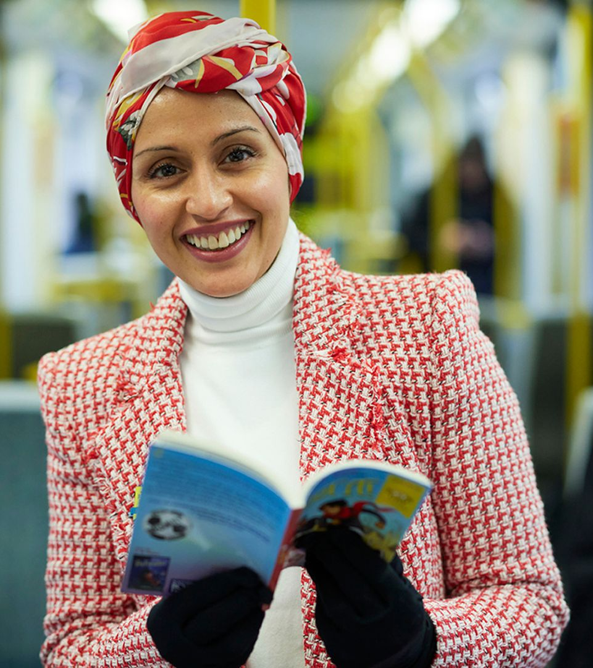
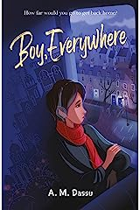
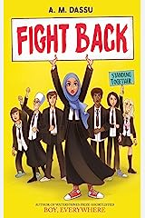
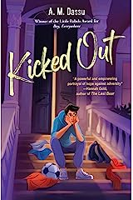
D – A.M. Dassu
A.M. Dassu pens inclusive children's and young adult literature. Her powerful storytelling addresses identity, belonging, and resilience, resonating with diverse readers. Dassu's works serve as mirrors for underrepresented communities and windows to foster empathy. With compelling characters and thought-provoking plots, her books inspire and showcase the transformative power of literature.

Slide 13
D – A.M. Dassu
It all started going wrong during English. It was the last lesson on Thursday before the weekend, we’d just finished reading To Kill a Mockingbird and Miss Majida stood at the whiteboard going through some comprehension questions. I was scribbling them down, my head resting on my arm, when Leila tapped me on my shoulder from behind and handed me a note. Are you coming ice-skating tomorrow? I’d started writing back when the door flew open and Mr Abdo, our principal, burst into the room. I shot up from my desk the second he entered and straightened my shoulders. Everyone’s eyes were fixed on Mr Abdo, their faces blank. ‘Pack your bags. You’re all to go home,’ he said, rubbing the creases on his tired, worn face. ‘See you back here on Sunday morning.’ We didn’t need telling twice. Everyone slapped their books shut and the room erupted into noisy chatter. My best friend Joseph turned to me and our eyes locked in confusion. ‘Your parents and guardians have been called and are on their way to collect you,’ Mr Abdo added, loosening the knot in his tie, his lips thin and tight, lines deepening across his brow. ‘But why, Sir?’ asked someone from the back of the class. ‘There’s been a bombing. This is not a drill, eighth grade. We need to get you all home. You know the protocol.’ A collective gasp rose from the room. 6 Through the sash windows, the sky was a clear blue. I couldn’t see any smoke. Everything looked normal. The old orange tree stood firm in the sunlit courtyard, the gold crescent moon on top of the mosque’s minaret gleamed in the distance. Behind it the red, white and black-striped flag on top of the church tower fluttered gently in the breeze, cars were hooting their horns and the newspaper seller was still shouting out to people passing by his stall. Where had the bomb gone off? Panic prickled through me as I thought of home. I wished phones were allowed in school so I could just call to see if Mama, Baba and Sara were okay.
Extract

Slide 14
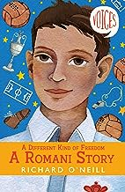
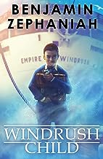
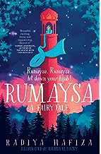
D – A.M. Dassu
Similar Authors
Richard O’Neill
Benjamin Zephaniah
Radiya Hafiza

Slide 15

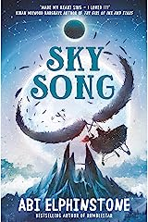
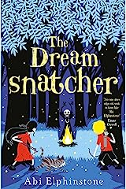
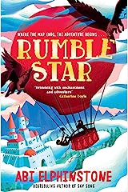
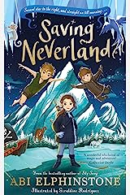
E – Abi Elphinstone
Abi Elphinstone weaves enchanting tales for children. Her captivating storytelling transports young readers to magical worlds, brimming with adventure and wonder. Through her books, Elphinstone instils courage and perseverance in her characters, encouraging children to face challenges with determination. With imaginative plots and richly developed settings, her works ignite the imagination and nurture a love for reading. Abi Elphinstone's books are a gateway to extraordinary journeys that leave a lasting impact on young minds.

Slide 16
E – Abi Elphinstone
Beyond the footsteps of the greatest explorers and up past the reach of the trustiest maps there lies a kingdom called Erkenwald. Here, the sun still shines at midnight in the summer, glinting off the icebergs in the north and slipping between the snow-capped Never Cliffs in the west. But it does not rise at all in the long, cold winters. Then, the nights bleed on and on and the darkness is so thick you cannot see your hands in front of your face. This far north, even the stars do not behave as you might expect. And that is probably just as well because without Ursa Minor breaking a few rules we would not have a story at all . . . The Little Bear, some call this constellation, but if astronomers knew the truth – if they could see into the heart of things and out the other side – perhaps they would have used a different name. For these seven stars are in fact Sky Gods, mighty giants carved from stardust, and the brightest of them all, the North Star, was the one who first breathed life into Erkenwald. 2 Such was his power that he only needed to blow the legendary Frost Horn once and the empty stretches of ice many miles below began to change. Mountains, forests and glaciers appeared. Then animals arrived: polar bears to roam the tundra, whales to glide through the oceans and wolves to stalk between the trees. Finally, the music of the Frost Horn conjured people: men and women of different shapes, sizes and colours scattered throughout the land. As the years passed, these men and women formed three tribes: the Fur Tribe built tipis from caribou hides in a forest to the south of the kingdom; the Feather Tribe settled inside caves in the Never Cliffs to the west; and the Tusk Tribe built igloos along the cliff tops on the northern coast. Each tribe had their own customs and beliefs, but they lived in harmony with one another, sharing food whenever they passed and offering shelter when the weather closed in.
Extract

Slide 17
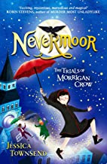
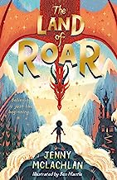
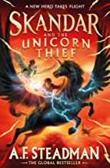
E – Abi Elphinstone
Similar Authors
Jessica
Townsend
Jenny
McLachlan
A.F.
Steadman

Slide 18
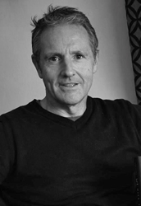
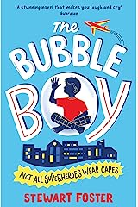
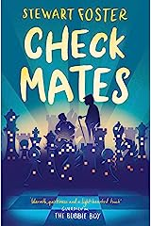
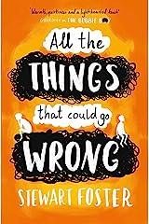
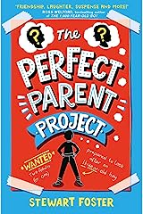
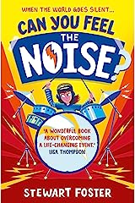
F – Stewart Foster
Stewart Foster creates touching and heartfelt stories for young readers. His works delve into emotional themes with compassion and authenticity, making them deeply relatable to children and teenagers. Through his characters' struggles and triumphs, readers will learn valuable life lessons about resilience, friendship, and empathy. With a writing style that effortlessly captures hearts, his books are powerful tools for inspiring compassion and understanding. Stewart Foster's stories are a treasure trove of emotions that resonate long after the final page is turned.

Slide 19
F – Stewart Foster
‘I’ve got a tattoo. Guess what it is?’
‘A giraffe?’
‘On my ankle?’
‘Okay, an elephant.’ Beth touches me on my arm. ‘Come on, Joe,’ she says.
‘You’re not even trying.’
‘Sorry. Show me it?’ She smiles then pulls up the right trouser of the overalls that all visitors have to wear, even family. ‘Last guess?’ ‘Spider-Man?’ ‘No.’ She laughs. ‘You can get that one when you’re older.’ We look at each other and say nothing. She used to say she was sorry. I used to tell her it was okay, that it didn’t matter. Now we just look at each other then look away, pretending nothing’s happened. She pulls down her sock and I look at the tattoo which is grey and red with a bit of blue in the middle. 2 ‘Looks like a smudge.’ ‘It’s a turtle dove! . . . And it itches.’ She scratches the turtle dove so hard that I think it might come off . I shake my head at my sister. Beth covers her tattoo, gets up and we stand side by side with the monitor beeping every thirty seconds beside us. We look out at the big grey building opposite with the sun shining on its windows and all the people inside sitting at their desks, staring at their computers. I see them come in and I see them leave, and during the nights and over the weekends I see the empty seats and the lights on dim until Monday morning when all the people come back again. The air-con clicks, pushes cold air around the room and makes me shiver. Beth asks me if I’m okay and I nod. ‘It’s too hot outside, but it feels cold in here.’ ‘Is it hot enough to make tarmac melt?’ I ask. ‘No, not that hot.’ She smiles then puts her arm round me and we stand looking out of the window, watching the planes as they fly above the tall buildings on the flight path in and out of Heathrow.
Extract

Slide 20
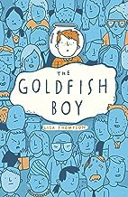
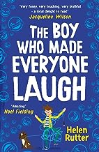
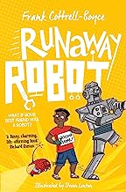
F – Stewart Foster
Similar Authors
Lisa
Thompson
Helen
Rutter
Frank Cottrell-Boyce

Slide 21
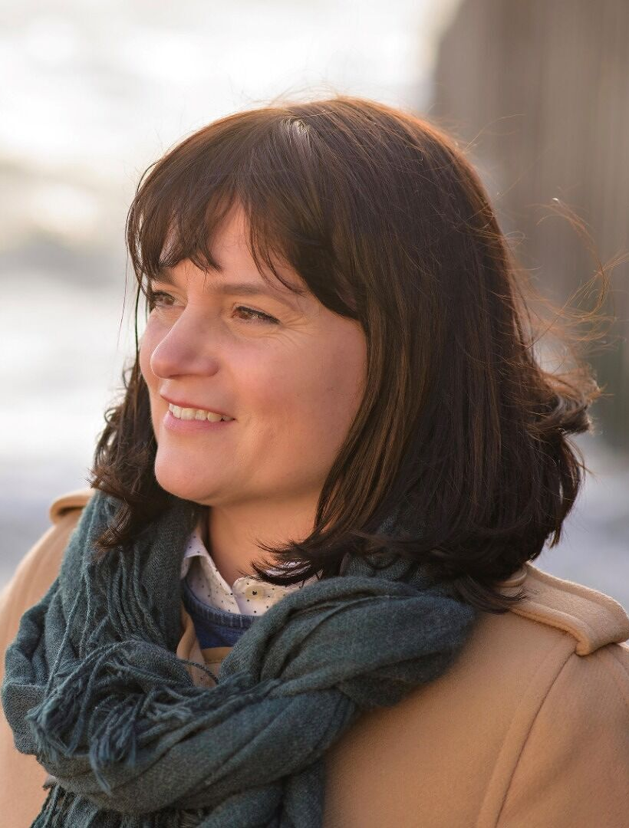
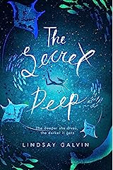
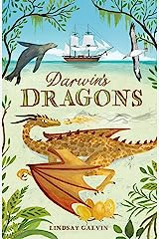
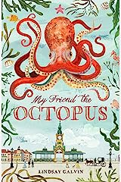
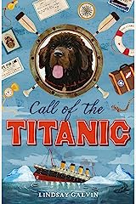
G – Lindsay Galvin
Lindsay Galvin is a master at crafting thrilling adventures for young readers. Her books immerse readers in gripping plots and high-stakes journeys, keeping them on the edge of their seats. Galvin's strong and relatable characters serve as inspirations for courage and determination. Through her vivid storytelling, she sparks curiosity and a love for exploration in her audience. Lindsay Galvin's works offer an exciting escape into worlds of mystery and discovery, making her an exciting addition to any young reader's bookshelf.

Slide 22
G – Lindsay Galvin
lfonso gazed back at the shimmering island of Madeira longingly as it disappeared over the horizon. Soon the sun would join it. 'We'll start around here, my good man, said the English gentleman, Senhor Bickerstaff. He dabbed his forehead with a purple silk handkerchief, although the evening was cooling. Alfonso's father released the sails and the boat rocked as it dropped speed, but Bickerstaff repeated his instruction loudly. Aqui, aqui. Compreendo?" Alfonso suppressed a smile at the man's exaggerated Portuguese accent, and his older brother shot hin glare. This estrangeiro had paid very well. His father nodded at Bickerstaff. "Comprends senbor. He unspooled the rope, and the net hit the wave and sank. 'Deeper, man, I need something that hasn't been see before. Profundo!' He circled his finger, eyes wide and bulging, as if showing the fisherman how the pulley worked. With a nod from his father, Alfonso tugged the rope so just a breath of breeze caught in the sail, edging them forward, dragging the net behind them in the deep. the English gentleman wanted to waste his money cruising empty seas at night, it was his lookout.
The boat gave an almighty lurch to one side so the sea surface was in touching distance for a few brief moments, and they all grasped something to stop them selves toppling in. A cry of alarm from Bickerstaff. They must have hit a wayward shoal after all. Alfonso leapt to release the sails as his brother and father heaved on the winch. This really was a haul-
But Alfonso's first glimpse was not of a mass of writhing silver fish. The net was swollen, but what filled it was darker and denser than the ocean below it. Something huge.
Extract

Slide 23



G – Lindsay Galvin
Similar Authors
Emma
Carroll
M.G. Leonard
Ally
Sherrick

Slide 24






H – Cath Howe
Cath Howe weaves captivating stories that resonate with young readers. Her books embrace relatable themes and emotions, connecting deeply with children. Howe's narratives are filled with genuine characters, exploring friendship, family, and self-discovery. Through her engaging storytelling, she imparts valuable life lessons about empathy, resilience, and acceptance. Cath Howe's works are a delightful blend of heart and imagination, inspiring young minds to find their voices and appreciate the beauty of storytelling. Her books stand as a testament to the transformative power of literature in shaping young hearts and minds.

Slide 25
H – Cath Howe
Dear Dad, When I look up into the sky some days, I feel better because I know it must be the same view for you when you look up. If you saw a bird, maybe it would be fying over my house a bit later on. But then, other days, it’s worse. The sky seems so big it makes me feel as if you are a very, very long way away. Do you think we could both always look out at the sky at the same time each day, like, maybe, seven o’clock in the morning? I think that might help. Shall we choose a time? Shall we do that, Dad? Love, Ella
Extract
“Hellooo, puss.” I stepped across the grass towards the grey cat under the tree and held out my phone to get a picture. I clicked my tongue. She turned her head. Perfect! The sunlight was falling on her back just right, lighting her stripes gold. “Ella!” Suddenly Mum was in the garden beside me, all smart in her suit. “I need you inside now, Ella!” “But I have to take more photos,” I said. “You’ll have to do them later.” “But they’re for Dad!” Mum’s jaw locked. “Look, love, I’ve got to get to work after I drop you at school. I said I’d be in by nine o’clock. If we’re not in the car in five minutes, we’ll all be late.” I trailed after her, back into the kitchen. “Put this on.” She held out a blue cardigan. Its little gold buttons glinted. “That’s blue. The uniform’s green.” “I’ve ordered your uniform. It’s not my fault if it hasn’t come yet. Look, love, this is quite … greenish.” Mum locked the back door and shut the dishwasher “It’s not green!” I said. “And it’s for an old woman! I can’t wear it.” Mum slammed down our new lunchboxes, glaring now. “Ella! Jack’s in his home clothes too.” I looked over at Jack at the breakfast table, cereal spilling out of his grinning mouth.

Slide 26



H – Cath Howe
Similar Authors
Libby Scott &
Rebecca Wescott
Tamsin
Winter
Ben
Davis

Slide 27





I – Eva Ibbotson
Eva Ibbotson, a literary treasure, has left an indelible mark on children's literature. Her captivating stories whisk readers away to enchanting worlds, brimming with magic and wonder. Ibbotson's keen wit and imaginative prose create unforgettable characters that resonate with readers of all ages. Through her tales of courage, kindness, and love, she imparts timeless lessons about the human spirit. Eva Ibbotson's books are a delightful blend of fantasy and heart, leaving a lasting legacy as cherished classics that continue to inspire generations of readers.

Slide 28
I – Eva Ibbotson
All Hal had ever wanted was a dog. He had wanted one for his last birthday and for the birthday before, and for Christmas, and now that his birthday was coming round again he wanted one more desperately than ever. He had read about dogs and dreamed about dogs; he knew how to feed them and how to train them. But whenever he asked his mother for a dog she told him not to be silly. 1 “How could we have a dog? Think of the mess; hairs on the carpet and scratch marks on the door, and the smell. . . Not to mention puddles on the floor,” said Albina Fenton, and shuddered. And when Hal said that he would see to it that it didn’t smell and would take it out again and again so that it didn’t make puddles, she looked hurt. “You have such a beautiful home,” she told her son, “I would have thought you would be grateful.” This was true in a way. Hal’s parents were rich; they lived in a large modern house in the suburbs with carpets so thick that your feet sank right into them and silk curtains that swept to the floor. There were three new cars in the garage – one for Albina, one for her husband and one for the maid to use when she took Hal to school – and five bathrooms with gold taps and power showers, and a sauna. In the kitchen every kind of gadget hummed and buzzed; squeezers and coffee makers and extractors – and the patio was tiled with marble brought in specially from Italy. But in the whole of the house there was nothing that was alive. Not the smallest beetle, not the frailest spider, not the shyest mouse – Albina Fenton and the maids who came and went saw to that. And in the garden there were no flowers – 2 only raked gravel – because flowers mean earth and mess.
Extract

Slide 29



I – Eva Ibbotson
Similar Authors
Katherine
Rundell
Kiran Milwood
Hargrave
Piers
Torday

Slide 30





J – Sharna Jackson
Sharna Jackson, a brilliant author, is a trailblazer in children's literature. Her works effortlessly combine thrilling mysteries with diverse and relatable characters. Jackson's books empower young readers with strong protagonists who tackle challenges with intelligence and determination. Through her captivating storytelling, she encourages curiosity and critical thinking. Sharna Jackson's narratives serve as mirrors for underrepresented communities, fostering inclusivity and representation in children's literature. With her unique voice and compelling plots, she leaves an indelible impact on young minds, making her an essential and exciting addition to any reading list.

Slide 31
J – Sharna Jackson
If you think finding a body is a fun adventure, you're 33% right.
Hugo Knightley-Webb, 45. Antiques dealer and occasional art teacher. Curly white hair. Straight-up dead.
This was a fact. One I could confirm personally because we - Norva and I - just found his body. 14:27 on July 23rd. The hottest day of the year so far. Thirty- five degrees, and rising.
We knew we'd find him. It wasn't coincidence or happenstance. No. We knew. But prior knowledge didn't make the discovery any less shocking or painful. Or smelly.
We located the body using a system I call my Triangle of Truth. Naturally, it has three angles:
Facts, Evidence, Deduction
That's just how I work. Me: Anika "Ni Alexander, 11. Science-led with a shaved head.
Norva Alexander, 13. My sister. Long braid short temper. My partner in (solving) crime. She has her own system. She feels things in her:
Stomach, Bones, Waters
Whatever waters are. I try not to think about Norva's liquids too much.
That's an apt summation of our collaboration, actually Norva shouts theories and says seemingly stupid stuff. I then organise those words, and think about them critically. This is, according to Norva, teamwork. According to her, she's the Gut and I'm the Nut. I should be offended, but I'm not. I'm used to it.
To be fair to Norva, we both strongly suspected something was wrong through our noses. It smelled wrong on The Tri since Saturday. Dead wrong.
Extract

Slide 32



J – Sharna Jackson
Similar Authors
Robin
Stevens
Patrice
Lawrence
Fleur
Hitchcock

Slide 33





K – Padraig Kenny
Padraig Kenny crafts imaginative stories that transport young readers to magical realms. His books are filled with whimsical adventures and endearing characters that captivate the imagination. Kenny's narratives touch on profound themes of friendship, courage, and resilience, leaving a lasting impact on young hearts. With a delightful blend of fantasy and heart, his works inspire a love for reading and ignite the spark of creativity in children. Padraig Kenny's books are a treasure trove of enchantment and wonder, making them beloved favourites among young readers.

Slide 34
K – Padraig Kenny
Mirabelle was in the garden feeding bones to the flowers when Uncle Enoch came for her.
The flowers swayed above her, sniffing the night air. She could hear the creaking of their tree-trunk-thick stalks and the soft wet sibilance of their petals smacking together as they fed. Though they were nursery plants, each one of them was already over six feet tall, their heads moving blindly in the starry night. A light breeze was blowing. Mirabelle inhaled the air. It was grass-scented and warm. Behind her in the great house, she could sense the others stirring from their day-long slumber.
A shadow moved over the moon. Mirabelle smiled as she heard the light flapping of wings and the sound of feet touching the earth.
'Good evening, Uncle Enoch.'
The tall black-clad figure stepped out of the darkness, his wings melting into the air behind him. His pale face was dominated by a long nose. His jet-black hair was pasted back over his skull in a widow's peak. He had an austere presence, but there was genuine warmth in his eyes.
'Good evening, Mirabelle. How was the day?' Mirabelle sniffed. 'Bright and sunny.'
Enoch shook his head. 'Not my cup of tea."
He reached into the bucket beside Mirabelle, fished a bone out and threw it up in an arc. One of the flowers whipped forward and snatched it from the air. Another hissed at it, then turned away and went back to bobbing its head.
'They're very hungry,' said Enoch.
"They're always hungry,' said Mirabelle.
Extract

Slide 35



K – Padraig Kenny
Similar Authors
Phil
Hickes
Jennifer
Killick
Philip
Reeve

Slide 36





L – L.D. Lapinski
L.D. Lapinski writes enchanting tales for young readers. Their books transport audiences to wondrous worlds filled with magic and imagination. Lapinski's compelling characters embark on thrilling adventures that captivate the mind and heart. Through their narratives, Lapinski imparts important life lessons about bravery, friendship, and embracing one's uniqueness. L.D. Lapinski's works inspire young minds to dream and believe in the power of their own stories. With their imaginative prose and heartwarming themes, L.D. leaves a lasting impression on readers.

Slide 37
L – L.D. Lapinski
There have always been places in our world where magic gathers.
You can see it, if you look close enough. You might see an ancient horse and cart passing down a modern high-street; or a cobbled alleyway that people walk into, but never out of. Now and again, you might see it in a person - someone who looks like they've stepped straight out of an old photograph. Or, perhaps, someone whose bag seems to hover off the ground catches your eye in a coffee shop. And when you look again they, and their bag, have disappeared.
And, occasionally, you see magic in shops. Squashed between brand name stores and fancy displays, the shops soaked in magic are nevereye-catching, or ostentatious. Their windows are stained with dirt and dust, and sometimes their signs have peeled away so much that it looks as though ghost letters are trying to work their way through. Magic does not wish to be noticed, you see. And most people are happy to pretend it does not exist.
The Strangeworlds Travel Agency was very much like a magical shop should be.
The leaded windows were dirty and cracked. There was peeling paint on the front door and it hardly ever seemed to be open. However, there was one element of the shop that refused to fade into the background: the sign over the window. It was always clearly painted, in silky gold letters embellished with black against a ruby- red background. There was one globe at the beginning of the sign and another at the end. The shop was out of its time, for certain, and yet the name was blazoned for all to see.
STRANGE WORLDS TRAVEL AGENCY
Extract

Slide 38



L – L.D. Lapinski
Similar Authors
Louie
Stowell
Benjamin
Dean
P.G.
Bell

Slide 39





M – Elle McNicoll
Elle McNicoll is a wonderful addition to the world of children's literature. Her books beautifully explore diverse themes and characters, deeply connecting with young readers. McNicoll's stories empower children by addressing important topics with sensitivity and authenticity. Through her engaging storytelling, she promotes understanding and empathy, encouraging inclusivity and acceptance. Elle McNicoll's narratives serve as a mirror for underrepresented voices, fostering a sense of belonging and representation for all readers. With her heartfelt and compelling works, she cements herself as a prominent advocate for diversity and a beloved author for young audiences.

Slide 40
M – Elle McNicoll
“Do you know what makes you different, Cora? Could you tell us?” I don’t answer the question immediately. Instead, I look around the room. It’s as white, and as clean, as the inside of a bathtub. One large mirror on the wall to my right. Adrien warned me that this place was all smoke and mirrors. Whatever that means. “Cora?” I look back in her direction, not making eye contact. Dr Gold is different. Not like the other scientists that work here. She laughs with her whole body and has a glow about her. She is smiling at me, awaiting my answer. They’re super smart, but no one can be clever about everything. Adrien told me about them. Prepared me. His dad runs this facility and Adrien has sat right in this chair. In the uncomfortable spot that I’m currently fidgeting in. He’s answered the questions. I can do this too. Adrien. Adrien is my best friend. And I’m doing all of this for him.
Chapter 1
“I don’t see why I have to come with you both,” I say, scowling at my older brother Gregor and my dad as they rush me out of the front door and into our junky old car. “It’s this little thing called the law, Cora,” Dad says, as he cheerfully pushes me into the backseat while Gregor frantically checks his reflection in the rear-view mirror. “I’m not allowed to leave you alone in the house. Especially after what you did to the toaster.” “The guy from the fire brigade said that happens all the time. Besides, you’re going to let me run around London all by myself during the summer,” I argue. The engine starts and we back out onto the road, setting off for the posh part of town. “That’s way more dangerous than our house, people drive like maniacs nowadays.” “Don’t I know it,” Gregor mutters, as Dad flies over a speedbump, causing my brother and I to grab our armrests and hold on for dear life.
Extract

Slide 41



M – Elle McNicoll
Similar Authors
Patrice
Agbabi
Lizzie Huxley-Jones
Aoife
Dooley

Slide 42




N – James Nicol
James Nicol captivates with magical adventures that enchant young readers. His books transport audiences to fantastical worlds where imagination knows no bounds. Nicol's relatable characters embark on thrilling quests, teaching valuable lessons about bravery and friendship. Through his skilful storytelling, he sparks curiosity and ignites a love for reading in children. James Nicol's works inspire young minds to embrace their uniqueness and believe in the power of their dreams. With his charming narratives and delightful prose, he leaves an enchanting mark on the realm of children's literature.

Slide 43
N – James Nicol
Witches of Hylund,’ the poster declared, ‘Your country needs you! Join up TODAY!’ Arianwyn stared up at the elegant woman gazing proudly from the poster. The woman’s hair was golden and flowing, her lips bright red. She wore the dark navy uniform and the silver star of a fully trained witch. Arianwyn glanced down at her coat and the space that her own star would soon occupy. Far-off bells sounded the hour, cutting through the noise of busy morning traffic rushing past, horns screaming out across the bustling street. She would be late if she stood daydreaming much longer. Grabbing her bag, she skipped between the crush of passers-by through tall wrought-iron gates, following the signs for Registration. Steps led through an open doorway and into a long, gleaming corridor. Other witches rushed past – some now proudly displaying bright new stars and broad grins – and administrative staff carrying stacks of files or clutching clipboards. The air was full of excited chatter and the tang of damp wool coats and antiseptic. Arianwyn’s wet shoes squeaked across the polished floor. She joined one of several haphazard queues and suddenly wished she hadn’t. Gimma Alverston was handing over her identity card at the desk, surrounded as ever by a small group of other young witches. Gimma looked just like the witch on the poster outside, all flowing golden hair and bright smile. Arianwyn patted nervously at her own messy curls and tried to shrink back into the line. But she was too late – and too tall. One of the other girls – a smart-looking witch who Arianwyn recognized as Polly Walden – nudged Gimma and pointed in her direction. Gimma glanced over, offered a mean, tight smile and whispered something to the others. The corridor rang with cruel giggling and Arianwyn went red. This is all I need, she thought. What did I ever do to her?
Extract

Slide 44



N – James Nicol
Similar Authors
Anna
James
Ross
Montgomery
Lorraine Gregory

Slide 45





O – Sinead O’Hart
Sinead O'Hart enchants her readers with spellbinding stories. Her books whisk readers away on breathtaking adventures filled with mystery and wonder. O'Hart's compelling characters journey through fantastical worlds, inspiring courage and resilience. Through her imaginative storytelling, she sparks curiosity and ignites a passion for discovery in children. Sinead O'Hart's works inspire a sense of wonder and possibility, encouraging young minds to dream and embrace the magic within themselves. With her captivating narratives and imaginative prose, she leaves an enduring mark on the hearts of young readers.

Slide 46
O – Sinead O’Hart
For as long as she could remember, Emmeline Widget had been sure her parents were trying to kill her. Why else, she reasoned, would they choose to live in a creaky old house where, if she wasn’t dodging random bits of collapsing masonry or avoiding the trick steps on the stairs, she had to be constantly on guard for boobytrapped floorboards or doors that liked to boom closed entirely by themselves? She’d lost count of the number of close calls she’d already clocked up, and so she never went anywhere inside her house – not even to the bathroom – without a torch, a ball of twine, and a short, stout stick, the latter to defend herself against whatever might come slithering up the drain. She’d started her fi ght for survival early. As a baby, she’d learned to walk mostly by avoiding the tentacles, tusks, and whiplike tongues of the various 2 small, furry things in cages that would temporarily line the hallways after one of her parents’ research trips. And she’d long ago grown used to shaking out her boots before she put them on in the morning – for, as Emmeline had learned, lots of quiet, dangerous, and very patient creatures liked to hide out in abandoned footwear. Outside the house wasn’t much better. The grounds were overgrown to the point that Widget Manor itself was invisible unless you managed to smack right into it, and that kind of lazy groundskeeping provided a haven for all sorts of things. The year Emmeline turned seven, for instance, her parents had come home from an expedition with a giant squirrel in tow, one with teeth as long as Emmeline’s leg. It had wasted no time in getting loose and had spent three weeks destroying half the garden before finally being brought under control. Some times, particularly on windy nights, Emmeline wasn’t entirely sure her parents were telling the truth when they said the squirrel had been sent back to its distant home. Even worse, a roaring river ran right at the end of their property, sweeping past with all the haughtiness of a diamond-encrusted duchess.
Extract

Slide 47



O – Sinead O’Hart
Similar Authors
Struan
Murray
Helena
Duggan
Peter Bunzl

Slide 48






P - Jenny Pearson
Jenny Pearson captures hearts with her heart-warming and humorous stories. Her books resonate with young readers, blending relatable characters and uplifting messages. Pearson's tales teach valuable life lessons about kindness, empathy, and self-discovery. Through her engaging storytelling, she fosters a love for reading and sparks laughter in children. Jenny Pearson's works are a delightful mix of heart and humour. Her books are cherished favourites among many readers.

Slide 49
P - Jenny Pearson
The idea came to me after I was sent home from school on the last Wednesday of term for punching Billy Griggs on the nose. And even though he’s the reason I had to miss the last two days of Year Six, I guess he’s also the reason I ended up on a TV talent show in front of a live studio audience, asking the eighties pop star Paul Castellini if he’d like to help my mum. So if you were to say, “Lucy, do you regret walloping Billy’s nose?” I’d say, “All things considered – it was probably worth it.” It was the day of our end-of-Year-Six presentations. We had to do a talk on a topic we were passionate about. Jack Perkins was up first, and he talked about the best football team in history, which, frankly, was always going to cause a massive argument. When Mrs Hunter finally got everyone to shut up by clapping her hands really loudly, she turned to Dylan Fry and told him he was next. But when he said he was going to do a talk about the real best football team in history, all the shouting started again. Mrs Hunter gave up on the angry clapping and instead yelled at us to be quiet. When eventually the noise had stopped, she did this massive sigh, muttered something at the ceiling about early retirement and then asked if anyone else wanted to go next. Sandesh raised his hand and started waving it about in a very eager way with his bum hovering above his seat. Mrs Hunter did this big swallow, flopped down on her wheelie chair and said, “Okay, Sandesh, your go. I’m guessing this is on—” And the whole class went, “GUINNESS WORLD RECORDS,” in one big droney voice. See, Sandesh has this thing about world records. Since he started in the summer term of Year Five, after he moved to Milton Keynes from south London, that is all anyone has heard him talk about.
Extract

Slide 50



P - Jenny Pearson
Similar Authors
Sam
Copeland
Danny
Wallace
Pamela Butchart

Slide 51





Q – Onjali Q Rauf
Onjali Q. Raúf tells powerful stories that touch the hearts of young readers. Her books tackle important social issues with grace and sensitivity, promoting empathy and understanding. Raúf's characters embark on journeys of courage and compassion, inspiring young minds to make a difference in the world. Through her compelling narratives, she sheds light on the strength of unity and the importance of standing up for what is right. Onjali Q. Raúf's works serve as a beacon of hope and change, making her a cherished voice in contemporary children's literature.

Slide 52
Q – Onjali Q Rauf
‘HECTOOOOOOOOORRRRRRRGGGGGH! STOP RIGHT THERE!’ I froze with my hand hovering above the large vat of bright red tomato soup. It would have been a perfectly ordinary pot of soup, if it hadn’t been for the long, bright green rubber snake that was now floating around right in the middle of it. ‘HECTOOOOORRR! I’M WARNING YOU!’ I slowly turned to look over my shoulder. I could see all the dinner ladies in their bright blue uniforms staring at me with their mouths wide open, like doors someone had forgot to shut. Everyone in the dinner hall had frozen. Except for Mr Lancaster. His mouth was open wide too, and getting wider like a big black hole. 2 I could tell he was getting ready to explode because his face had gone as pink as a baboon’s bottom, and his nose was starting to twitch. ‘Don’t you dare,’ he hissed, glaring at the second rubber snake I was holding in my hand. I looked down at the second snake. This one was bright red. Almost as bright red as the boring soup Mrs Baxter had made. I knew I had two options. The first one was to not drop the second snake in. I would still get punished for the green snake, but maybe it wouldn’t be quite as bad. The second option was to drop the snake in. That would make Mr Lancaster even madder than he already was and make Mrs Baxter really mad. But it would serve her right for being the worst dinner lady we’d ever had – always narrowing her eyes and giving us the smallest spoonfuls of the things we wanted, and plonking giant spoonfuls of the things we hated on to our plates. It was about time someone got her back. Plus it would make Will and Katie, my two best friends, laugh.
Extract

Slide 53



Q – Onjali Q Rauf
Similar Authors
Zanib
Mian
Catherine Bruton
S.E.
Durrant

Slide 54





R – Jason Reynolds
Jason Reynolds captivates readers with his powerful and relatable stories. His books explore diverse themes, resonating deeply with young audiences. Reynolds' authentic characters navigate through real-life challenges, reflecting the complexities of adolescence. Through his raw and emotive storytelling, he addresses important social issues with honesty and depth, encouraging empathy and understanding. Jason Reynolds' narratives connect with readers from all walks of life, making him a prominent advocate for inclusivity in children's literature.

Slide 55
R – Jason Reynolds
CHECK THIS OUT. This guy named Andrew Dahl holds the world record for blowing up the most balloons . . . with his nose. Yeah. That’s true. Not sure how he found out that was some kinda special talent, and I can’t even imagine how much snot be in those balloons, but hey, it’s a thing and Andrew’s the best at it. There’s also this lady named Charlotte Lee who holds the record for owning the most rubber ducks. No lie. Here’s what’s weird about that: Why would you even want one rubber duck, let alone 5,631? I mean, come on. And me, well, I probably hold the world record for knowing about the most world records. That, and for eating the most sunflower seeds. “Let me guess, sunflower seeds,” Mr Charles practically shouts from behind the counter of what he calls his “country store,” even though we live in a city. Mr Charles, who, by the way, looks just like James Brown if James Brown were white, has been ringing me up for sunflower seeds five days a week for about, let me think . . . since fourth grade, which is when Ma took the hospital job. So for about three years now. He’s also hard of hearing, which when my mum used to say this, I always thought she was saying “harder hearing,” which made no sense at all to me. I don’t know why she just didn’t say “almost deaf.” Maybe because “hard of hearing” is more like hospital talk, which was probably rubbing off on her. But, yeah, Mr Charles can barely hear a thing, which is why he’s always yelling at everybody and everybody’s always yelling at him. His store is a straight-up scream fest, not to mention the extra sound effects from the loud TV he keeps behind the counter – cowboy movies on repeat. Mr Charles is also the guy who gave me this book, Guinness World Records, which is where I found out about Andrew Dahl and Charlotte Lee. He tells me I can set a record one day. A real record. Be one of the world’s greatest somethings. Maybe.
Extract

Slide 56



R – Jason Reynolds
Similar Authors
B.B.
Alston
Kwame
Alexander
Jerry
Craft

Slide 57





S – Lucy Strange
Lucy Strange enchants young readers with her captivating tales. Her books transport audiences to evocative settings, where mysteries unfold and adventures abound. Strange's relatable characters navigate through personal journeys, grappling with emotions and self-discovery. Through her compelling storytelling, she sparks imagination and empathy, encouraging young minds to embrace their uniqueness. Lucy Strange's works are a perfect blend of heart and intrigue, leaving a lasting impression on young hearts.

Slide 58
S – Lucy Strange
We stood together, looking up at the new house – Father, Mama, Nanny Jane, Piglet and me. It was large and old, almost falling down in places, with gently bulging walls and a steep, tiled roof that was etched with lichen. The sign on the gatepost read HOPE HOUSE. ‘It’s a fresh start,’ Father said. Mama didn’t say anything. She just stared at our strange new home, and then turned to stare at Father. ‘Come on, Piglet,’ I whispered to the baby. ‘Let’s have a look around.’ I clutched her tightly to my chest and walked around the side of the house, towards the long garden and the wilderness of woodland that lay beyond. ‘Don’t be long,’ Nanny Jane called after me. ‘Be 1 back for tea in twenty minutes please, Henry.’ I had always been Henry, even though my full name was Henrietta Georgina Abbott. Maybe my parents had wanted two boys. Now that my brother Robert had gone, they had two girls. Just me and Piglet. Piglet wasn’t the baby’s real name either, of course. She had arrived during that terrible time last summer. Mama wouldn’t discuss what to call her, so Father had registered her as Roberta Abbott – a horrible mistake, but it was too late now. No one could bear to call her Roberta, so we called her Piglet because, well, she looked a lot like a baby pig. I liked the name because it reminded me of the baby in Alice’s Adventures in Wonderland. I felt a lot like Alice that day, exploring a new world in which nothing quite made sense. Piglet and I wandered past a dishevelled herb garden, an overgrown bed of rose bushes and a broken old gazebo, all the way down the length of the lawn to the point at which the garden ended and the forest began. Beneath the trees it was cool, dark and badgery. It had been a hot summer, and the leaves and twigs beneath my feet were as crisp as kindling. A tangle of overgrown pathways wound away into the darkness of the forest. I stopped and listened, but I could only hear the soft thrum of my own heartbeat and the whisper of Piglet’s breathing
Extract

Slide 59



S – Lucy Strange
Similar Authors
Natasha Farrant
Victoria
Williamson
Hilary McKay

Slide 60





T – Thomas Taylor
Thomas Taylorweaves mesmerizing stories that ignite the imagination of young readers. His books lead audiences on thrilling adventures, filled with captivating twists and turns. Taylor's relatable characters grapple with courage and friendship, imparting valuable life lessons. Through his skillful storytelling, he fosters curiosity and a love for reading in children. Thomas Taylor's works leave an indelible mark on young minds, inspiring them to dream and explore the magic of literature. His captivating narratives continue to enchant readers, making him a beloved and influential figure in children's literature.

Slide 61
T – Thomas Taylor
YOU’VE PROBABLY BEEN TO EERIE-ON-SEA, without ever knowing it. When you came, it would have been summer. There would have been ice cream and deckchairs and a seagull that pinched your chips. You probably poked about in the rock pools with your mum, while your dad found that funny shell. Remember? And I bet that when you got in the car to drive home, you looked up at the words CHEERIE-on-SEA – written in light-bulb letters over the pier – and got ready to forget all about your day at the seaside. It’s that kind of place. In the summer. But you should try being here when the first winter storms blow in, when the letters “C” and “H” blow off the pier, as they always do in November. When sea mist drifts up the streets like vast ghostly tentacles, and saltwater spray rattles the windows of the Grand Nautilus Hotel. Few people visit Eerie-on-Sea then. Even the locals keep off the beach when darkness falls and the wind howls around Maw Rocks and the wreck of the battleship Leviathan, where even now some swear they have seen the unctuous malamander creep. But you probably don’t believe in the malamander. You maybe think there’s no way a fish-man can be real. And that’s fine. Stick to your ice cream and deckchairs. This story probably isn’t for you anyway. In fact, do yourself a favour and stop reading now. Close this book and lock it in an old tin box. Wrap the box in a heavy chain and throw it off the pier. Forget you ever heard of Eerie-on-Sea. Go back to your normal life – grow up, get married, start a family. And when your children can walk, take them for a day at the seaside too. In the summer, of course. Stroll on the beach, and find a funny shell of your own. Reach down and pick it up. Only, it’s stuck to something… Stuck to an old tin box.
Extract

Slide 62



T – Thomas Taylor
Similar Authors
Mitch Johnson
David
Farr
Simon
Fox

Slide 63
U – urm.... sorry

Slide 64






V – Vashti Hardy
Vashti Hardy enchants young readers with her imaginative and adventurous stories. Her books transport audiences to extraordinary worlds, filled with wonder and magic. Hardy's relatable characters embark on thrilling quests, teaching valuable lessons about courage and resilience. Through her engaging storytelling, she sparks curiosity and a love for exploration in children. Vashti Hardy's works inspire young minds to believe in themselves and embrace their creativity.

Slide 65
V – Vashti Hardy
On the bright side of the valley, ten furrows from Lane End and some twenty furlongs from the village of North Owlcot, in a place where the great metal city of Medlock was just a dream, there was a small farm. The farmhouse was a time-worn cottage nestled in barley-swathed fields divided by drystone walls. Wayward geese busied themselves near the pond and sheep grazed around single-standing oak trees. Automaton farmers sowed seeds, while scarebots kept the crows at bay. Prue watched from the upper field, her elbows perched on the back of a broken mechanimal plough horse, oily hands clasped together, as a speck of a figure wound his way up the lane. Even from this distance, Prue could see there was a smart uprightness to the stranger’s walk unlike anyone she knew from the surrounding farms. As he neared, he paused and looked into the lower field where the automated potato digger ambled through the furrows, and Bess, one of the mechanimal dogs, patrolled, waiting to be called for evening herding. After a few moments, the stranger continued onwards and took the path towards the farm. When he turned, he looked up in Prue’s direction. She ducked behind the mechanimal horse, which in retrospect was pointless because she was certain he’d already seen her A sudden ping, followed by the squeak of metal, drew Prue’s attention to the ground in front of her. “Darn it!” she said as the hoppity wrench sprang merrily down the hill. Barley whipped her calves as she chased after it, its little steel jaws bobbing up above the golden tops before disappearing again. “Come back here, you little metallic monster!” She dived and wrestled with it for a moment, as it battled to jump away. This particular hoppity 3wrench not only seemed to have a loose restrainer, but a faulty homing device; it should’ve been able to make its own way back to the tool shed, but she had often found it hopping its way down the lane towards North Owlcot. Francis had tried to fix it last year, but he said some things just didn’t want to be fixed.
Extract

Slide 66



V – Vashti Hardy
Similar Authors
Tola
Okogwu
Polly
Ho-Yen
Catherine Doyle

Slide 67






W – Ross Welford
Ross Welford is a masterful storyteller who captivates young readers with his heart-warming and thought-provoking tales. His books tackle complex themes with sensitivity and humour, resonating deeply with audiences. Welford's relatable characters embark on extraordinary journeys, learning valuable life lessons along the way. Through his engaging storytelling, he fosters empathy and understanding, encouraging young minds to embrace kindness and acceptance. Ross Welford's works inspire a sense of wonder and curiosity, leaving his readers always wanting more.

Slide 68
W – Ross Welford
I’ve got this framed poster on my bedroom wall that Dad got me for my birthday. I see it every morning and every night, so I know it off by heart. THE WISDOM OF THE DOGS Don’t trust anyone who doesn’t like dogs. If what you want is buried, dig and dig until you find it. Don’t bite if a growl is enough. Like people in spite of their faults. Start each day with a wagging tail. Whatever your size, be brave. Whatever your age, learn new tricks. If someone is having a bad day, be silent, sit near and nuzzle them, gently. It’s all true. Every single word. As I discovered last summer, when the world nearly ended.
Ladies and gentlemen, boys and girls, allow me to introduce (drum roll . . .): Mr Mash: The Dog Who Saved the World! I love him more than anything. I know that sounds harsh on Dad and Clem, but I think they’ll understand, especially after what happened over that summer. We don’t know exactly how old he is, how he became a stray, or even what sort of dog he might be. He’s got shaggy fur – grey, brown and white – and ears that flop over at the ends. He’s got a cute, inquisitive face like a schnauzer, big soft eyes and a strong, very waggy tail like a Labrador. In other words, he’s a mishmash. When we got him from the St Woof’s shelter, the vicar said I could name him, and so I said ‘Mishmash’, which sounded like ‘Miss Mash’, but, because he’s a boy dog, he became Mister Mash. Mr Mash: my very best, very stupid friend. His tongue is far too big for his mouth, so it often just lolls out, making him look even dafter. He’s completely unable to tell if something is food or not, so he just eats it anyway. This, in turn, means he has what the vicar calls ‘a wind problem’. You can say that again. ‘Silent and violent,’ Dad says. ‘Disgusting,’ says Jessica, but she never liked him much anyway. Without Mr Mash, the world might have ended. Really.
Extract

Slide 69



W – Ross Welford
Similar Authors
Lissa
Evans
Alex
Cotter
Adam
Baron

Slide 70






X – AleX Bell
Alex Bell’s books are captivating stories that transport readers to magical realms and thrilling adventures. They are filled with richly developed characters, grappling with courage and self-discovery. Through her imaginative storytelling, Bell sparks curiosity and wonder, inspiring young minds to explore the depths of their imagination. Her works embrace themes of friendship, resilience, and the power of believing in oneself

Slide 71
X – AleX Bell
Stella Starflake Pearl rubbed frost from the turret window and scowled out at the snow. She ought to be in the most splendid mood - it was her birthday tomorrow, and the only thing Stella loved more than birthdays was unicorns. But it was hard to be cheerful when Felix was still refusing to take her on his expedi- tion. Even though she'd begged, pleaded, cajoled, threatened and stormed - none of it had done any good at all. The thought of be- ing packed off to stay with Aunt Agatha again made Stella feel positively sick. Aunt Agatha didn't know much about children, and sometimes she got things completely wrong, like the time she gave Stella a cabbage for her packed school lunch. No choco- late dinosaurs, or marshmallow cake, or treats of any kind - just a single, solitary, useless cabbage. Plus, Aunt Agatha had nostril hair. It was almost impossible not to sometimes stare at it.
Stella had wanted to be an explorer ever since she was old enough to know what the word meant. More specifically, she wanted to be a navigator. She never got tired of looking at maps and globes, and as far as she was concerned, a compass was just about the most beautiful thing in the whole entire world. After unicorns, obviously.
And if she wasn't meant to be an explorer, then why had the fairies given her a middle name? Everyone knew that only ex- plorers had three names. Felix had given her his last name, Pearl, but then hadn't known what to do about a first name, so he'd asked the fairies to name her instead. This was probably a good thing, because Felix was fond of peculiar names like Mildred and Wilhelmina and Barbaretta. But the fairies had given her not one name, but two: Stella and Starflake. And surely that meant that she was absolutely destined to be an explorer.
Extract

Slide 72



X – AleX Bell
Similar Authors
Aisling
Fowler
Katie & Kevin
Tsang
Loris
Owen

Slide 73





Y – Kelly Yang
Kelly Yangempowers young readers with her thought-provoking stories. Her books delve into important social issues and challenges faced by children from diverse backgrounds. Yang's relatable characters navigate through adversity, teaching valuable lessons about resilience and determination. Through her powerful storytelling, she fosters empathy and understanding, encouraging young minds to embrace compassion and stand up for what is right. Kelly Yang's works serve as a mirror for underrepresented voices, making her a prominent advocate for inclusivity in children's literature. Her books leave a lasting impression on readers, inspiring positive change in the world.

Slide 74
Y – Kelly Yang
My parents told me that America would be this amazing place where we could live in a house with a dog, do whatever we want, and eat hamburgers ‘til we were red in the face. So far, the only part of that we’ve achieved is the hamburger part, but I was still holding out hope. And the hamburgers here are pretty good. The most incredible burger I’ve ever had was at the Houston Space Center last summer. We weren’t planning on eating there — everybody knows museum food is fifty thousand times more expensive than outside food. But one whiff of the sizzling bacon as we passed by the café and my knees wobbled. My parents must have heard the howls of my stomach, because the next thing I knew, my mother was rummaging through her purse for coins. We only had enough money for one hamburger, so we had to share. But, man, what a burger. It was a mile high with real bacon and mayonnaise and pickles! My mum likes to tease that I devoured the whole thing in one gulp, leaving the two of them only a couple of crumbs. I’d like to think I gave them more than that. The other thing that was great about that Space Center was the free air-conditioning. We were living in our car that summer, which sounds like a lot of fun but actually wasn’t, because our car’s AC was busted. So, after the burger, my dad parked himself in front of the vent and stayed there the entire rest of the time. It was like he was trying to turn his fingers into popsicles. My mum and I bounced from exhibit to exhibit instead. I could barely keep up with her. She was an engineer back in China, so she loves maths and rockets. She oohed and aahed over this module and that module. I wished my cousin Shen could have been there. He loves rockets too. When we got to the photo booth, my mother’s face lit up. The booth took a picture of you and made it look like you were a real astronaut in space. I went first. I put my head where the cardboard cutout was and smiled when the guy said, “Cheese.” When it was my mum’s turn to take her photo, I thought it would be funny to jump into her shot. The result was a picture of her in an astronaut suit, hovering over Earth, and me standing right next to her in my flip-flops, doing bunny ears with my fingers.
Extract

Slide 75



Y – Kelly Yang
Similar Authors
Remy
Lai
Floella
Benjamin
Maisie
Chan

Slide 76




Z - Zillah Bethell
Zillah Bethell captures the hearts of young readers with her enchanting tales. Her books transport audiences to diverse and evocative worlds. Bethell's relatable characters embark on transformative journeys, navigating themes of friendship, resilience, and the power of hope. Through her evocative storytelling, she ignites young minds' curiosity and encourages a love for exploring new ideas

Slide 77
Z - Zillah Bethell
My name is Blue Wing and I live in my waspapi’s house. My waspapi is Siringen – the shark caller. Close to seventy-five ages old. From the clan of Tarangun. Son of the maker of paddles and the calmer of seas. But I am not a shark caller. “Why not?” It is a question I have asked Siringen a hundred thousand taim. “You know why,” Siringen replies for the hundred thousandth taim. “But I want to be able to call the sharks. You know this. I have told you for so long now that my jaw aches whenever I say it. I want to call the sharks. Teach me the magic and show me the ways. I may be a girl but I can do as well as – no, I can do even mobeta than – a boy.” I stick my chin out to show him I am tough and fierce. But Siringen knows all this anyway and just shakes his head for the hundred thousandth taim.
I stand on the edge of the moonflower coral and take a cormorant dive into the blue. My ears fill, my nose bubbles and my eyes sting; but I can see tru clear in this underwater kingdom and I can hold my breath for a very long taim. I somersault over an angelfish, then float for a while – sway, sway, sway – like a ribbon of seaweed in the beautiful cool. How many secrets live down here? How many tight-shut oyster shells? Nobody knows. Not even me. I climb back onto the reef, careful not to cut my feet on the coral that looks like chewing gum. The sun hits me with a slap. It is going to be a rude and uncivil person today, the sun. Soon the motorboat will come, bringing the tourists. “Blue Wing,” Siringen will say if I am close, or if I am far he will blow the taur shell to announce “It is time.” And I will dive off the coral, swim hard to the shore, take my place in the canoe. I look across the bikpela blue, beyond the leaping place, beyond the shark roads. There is a liklik black dot growing bigger and bigger, like a pupil in the darkness. Sea Ballerina is coming! I smile at the name, because this boat is no dancer on the waves. I turn to the shore. Siringen is waving at me. I wave back. Standing at the edge of the sunflower coral, I dive into the sea and start swimming fast… It is time to call the sharks.
Extract

Slide 78



Z - Zillah Bethell
Similar Authors
Nizrana
Farook
S.F.
Said
Kereen Getten

