Slide 1

Welcome to Year 1
Welcome to Year 1!
Your child will be working with:
Teachers - Mrs Merry (Monday-Wednesday)
Mrs Parker (Thursday and Friday)
Assistant - Mrs Tomlin

Slide 2

Working in partnership
“Let all that you do be done in love”
1 Corinthians 16:14
We act with love, build our faith and grow as people.

Slide 3
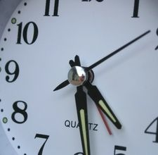
Breakfast Club starts: 7.45am
Drop off at the gates: 8.35am
Gates close 8:45am
Registration: 8.50am
Register closes: 9.00am
Lunchtime starts: 12.30pm
Lunchtime finishes: 1.30pm
School finishes: 3.15pm
Clubs after school 3.15-4.15pm
Splatz: 3.15- 6pm
Be on time! Even being just a few minutes late can get a child’s day off to a bad start.
During the first 10 or 15 minutes of the school day, children give in letters, choose lunch, organise their belongings, do their early work tasks.
Being 10 minutes late a few times a week adds up to 50 minutes – the length of an average English or Maths lesson.
Notes:
Order lunches at home

Slide 4

We want to know:
Inform us of any issues arising
Send an email to:
Secretary@smc-brackell.com

Slide 5

IMPORTANT NOTE:
Issues which arise in school should be dealt with in school by the school
Please do not approach other parents or children about incidents which have occurred in school, even if you know them well.

Slide 6

Social Media
We have an open door policy. If you have any concerns about the school or your child, please tell us directly.
Social media, or the playground, is not an appropriate forum to discuss issues concerning your children: it can often compound a problem and in our experience it is never part of the solution.

Slide 7

Every lesson counts.
Rules around requesting absence have changed – please do not request holidays in term-time.
If your child is ill, please let us know on the first day of absence and send in a letter explaining their absence on their return to school.
If your child is ill, please do not send them to school. If they have been sick, they need remain at home for at least 48 hours as sickness viruses are extremely contagious.

Slide 8
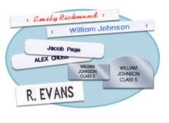

Uniform and Belongings
Your child is responsible for their own belongings.
The best way to support your child in doing this is to ensure that every item brought into school is clearly labelled..
Water bottles should be brought into school every day
( just water please).
PE kit in school on a Monday and home on Thursday evenings. All children to wear their PE kits on Fridays for Fit Friday. Please bring a coat to school every day!
Notes:
uniform (including socks)
Dresses/Skirts - Plain grey or white socks or plain red or grey tights
Trousers/Shorts - Plain grey or black socks.
PE uniform that must have appropriate length shorts (especially if choosing cycling shorts)
children must pack tracksuit bottoms as well as shorts for the weather.
Studs for earring NO hoops – better to have earrings out for PE days

Slide 9
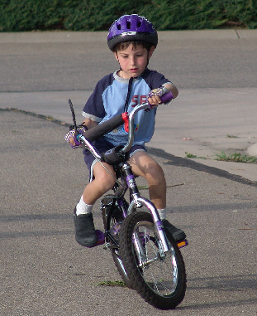
Independence
Pack/ empty own bag
Filling own water bottle
Take responsibility for letters
Taking care of own belongings
Labelling own belongings
Doing homework without reminders
Completing homework tasks independently – nothing new is set for homework, it is consolidation of class learning

Slide 10
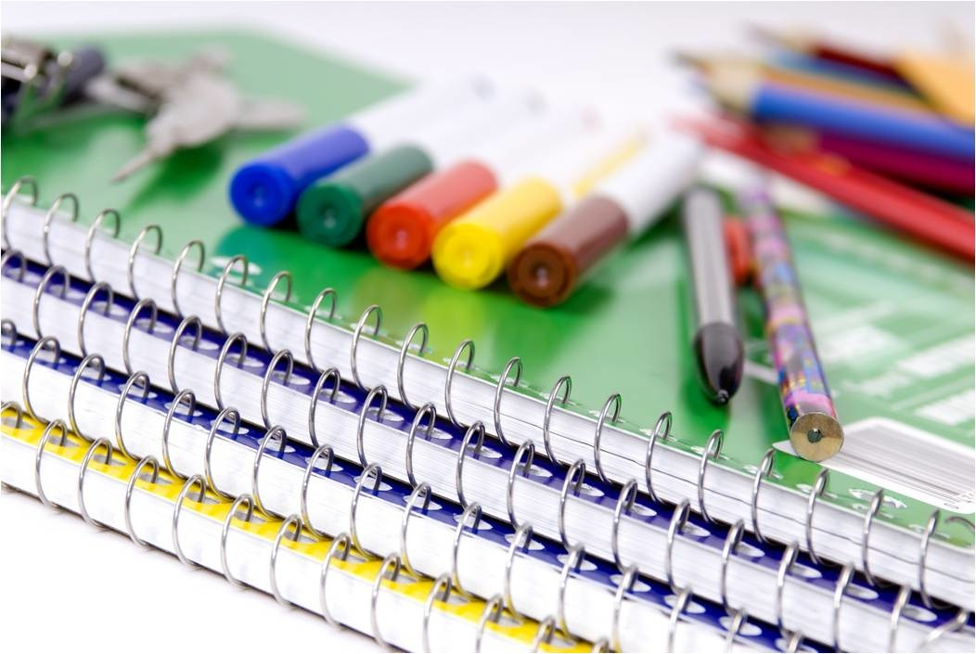
Pencil Cases
In Year 1, your children do not require a pencil case so please keep these at home.

Slide 11
St Margaret Clitherow School Rules
Follow
Follow instructions given by all adults in the school
Keep
Keep hands, feet and objects to yourself
Treat
Treat equipment sensibly
Show
Show respect to all members of our school community
Listen
Listen carefully and respond appropriately

Slide 12
Success today at SMC!
6 Huge Achievement
5 Excellent today
4 Feeling proud
3 Successful day
2 Well done
1 Great start

Slide 13
Bullying is never ok and always needs to be addressed
But bullying is not…
Not liking someone
Being excluded
Accidentally bumping into someone
Wanting to play a game their way
A single act of telling a joke about someone
Arguing
Isolated incidents of unpleasantness, aggression or meanness
However, all of these would be taken seriously and discussed as a learning point with your children.

Slide 14
There is no legal definition of bullying. However, it’s usually defined as behaviour that is:
repeated
intended to hurt someone either physically or emotionally
often aimed at certain groups, e.g. because of race, religion, gender or sexual orientation
It takes many forms and can include:
physical assault
teasing
making threats
name calling
cyber bullying - bullying via mobile phone or online (e.g. email, social networks and instant messenger)
Our anti-bullying policy is on the school website.

Slide 15
Places, partners and groups
Children will learn independently, in pairs and in groups.
Children’s places and groups will change regularly, according to learning styles, ability, social groups.
Children will work in several different groups over the course of a week.

Slide 16

Progress for every child
Work aims to be at correct level of challenge for each child
TA, SENCo or Class Teacher guided sessions
Additional support or challenge
Learning with others at similar level
Learning with others at different levels
Paired work
Same task, different expectations
Same objective, different task
Different objective, different task

Slide 17
Expected Progress in Year 1
Milestones have been set in order to ensure sufficient progress throughout the year.
Children making a slower rate of progress or who are at risk of not meeting their personal target are monitored closely, with various booster sessions and personalised tasks.
Children who are making accelerated progress are given opportunities to complete tasks which reflect their ability, with support as needed.

Slide 18
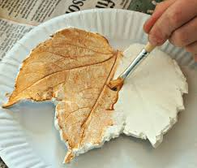
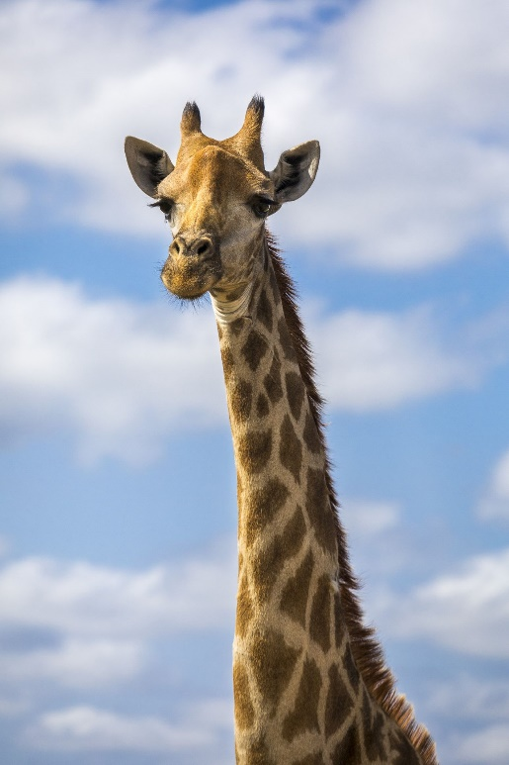
Topics in Year 1
Animals
Toys
Knights and Castles
Traditional Tales
Jack and the Beanstalk
Plants
The Seaside

Slide 19
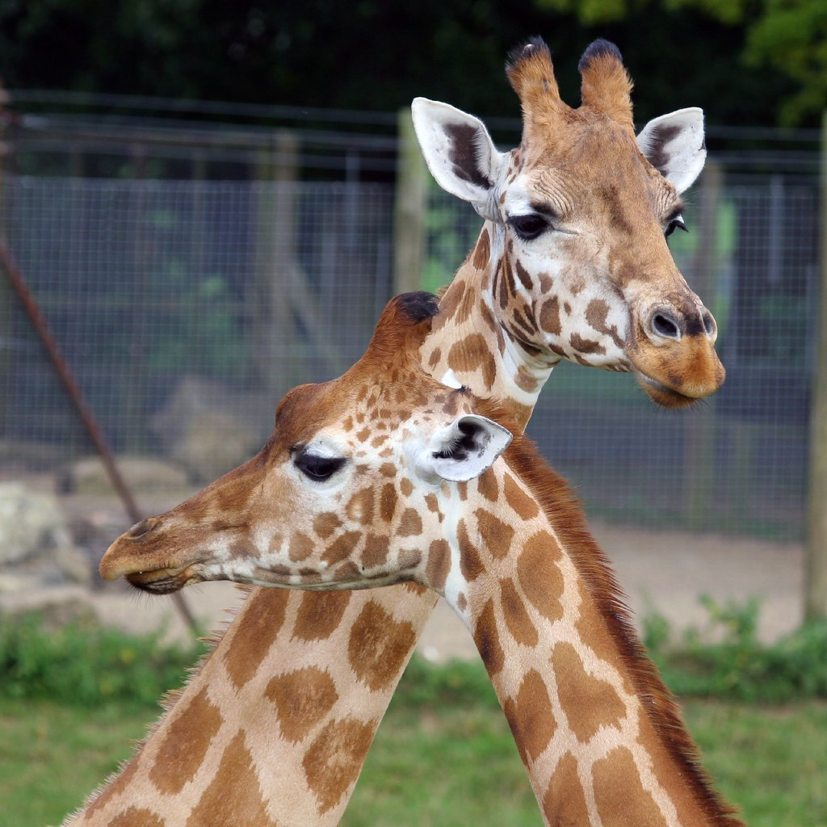
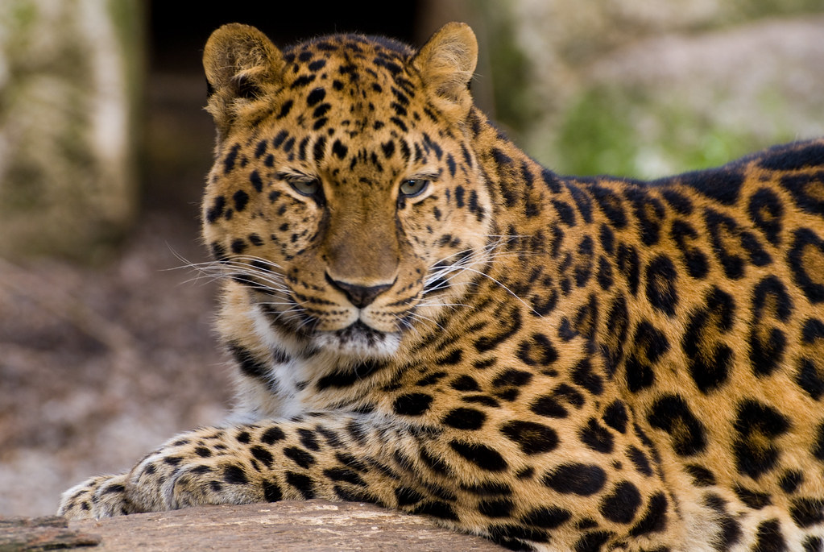
Trips
Our trip will be to Marwell Zoo in the summer term
Currently the estimated cost is around £30
Notes:
Updates will be sent out promptly

Slide 20
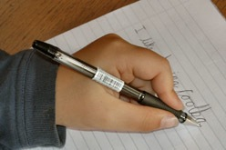
Handwriting
Handwriting does not need to be joined in Year 1.
We practise regularly in school .
Please encourage your child to show their best handwriting when completing homework in pencil.

Slide 21
Phonics
Our phonics scheme is Little wandle
Books are matched to what your child can read already
Phonics screening in June
Encourage children to use pure sounds when reading/writing at home.
Use soundmats with children if writing at home.

Slide 22
Reading
Please ensure that your child reads daily and you hear your child read aloud – aim for 10mins each day.
Reading is not just about de-coding. Ask your child questions which require them to make inferences and deduction from the text – in other words, can they read between the lines? There are some helpful questions at the back of each book.
Guided reading and related activities take place every day and is a key focus across the school.
Some children may be repeating a book set again. This is to build their confidence after the break.
Our library day is Friday, please return the books on Friday, ready to borrow a new book. If a library book from the previous week is not returned, we are unable to lend out a new book.
Reading is for pleasure too!

Slide 23
Purpose of Homework
Consolidates recent work
Reinforces basics
Informs future planning
Supports independent learning
Provides a dialogue about learning between child, parent and teacher
Celebrates success

Slide 24
Getting Homework
Given out on a Thursday
Submitted by the following Tuesday
It will be Handwriting, and Numbots.
Daily reading
May be differentiated or have an element of choice
Tasks are explained during lessons and examples worked through where necessary
Any problems, please see us or send a quick email ahead of when it is due!

Slide 25
Feedback for Homework.
Marvellous Me Housepoints are used to reward exceptional effort in homework.
Tasks should be completed independently. If a lot of support is needed, please let us know.
Please do not spend excessive time on homework (10 mins per piece is a guide – family life comes first!)
When in doubt work on the reading and the phonics as the priority.

Slide 26

There will be individual parent appointments on:
Tuesday 3rd November 1.30pm-7pm
Tuesday 2nd March 1.30 -7pm
Please make an appointment to see us at any time should the need arise.
Don’t wait if you have a concern!
Any questions?
Thank you for coming.

